Slide 1
how to recognize CB1
To recognize Cb1 there are two main conditions ... that is
1.There is a new hi after the previous hi
2.There are new low after the previous low
This condition should apply at the fibo level for higher accuracy

Slide 2
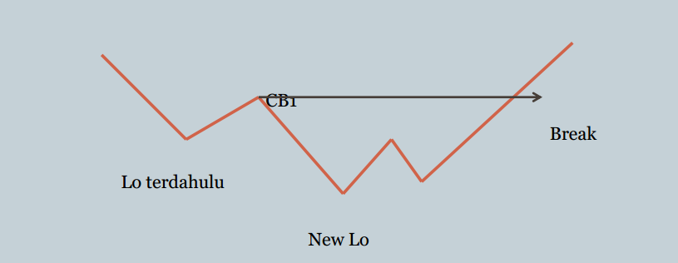
Between 2 LOWS =CB1- price break= UP

Slide 3
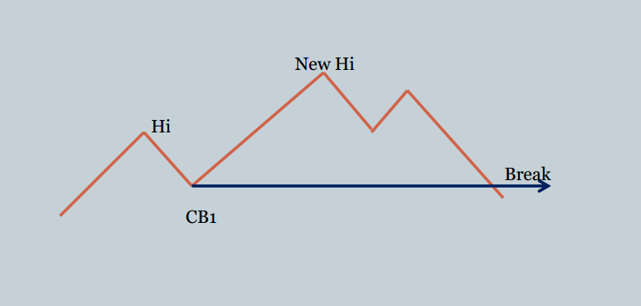
Between 2 HIGHS =CB1- price break= DOWN

Slide 4
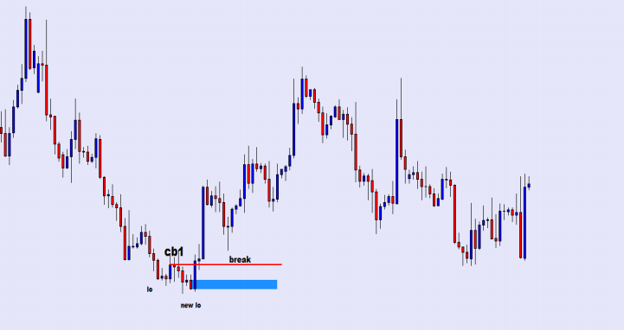

Slide 5


