Slide 1

Blue Sage Capital
Supply Grinding Swing
Fxdisciple
GBP/AUD
Date of Trade (Feb 13 2017)

Slide 2

Goal of the Month
The Goal of the month is to reduce the number of lesser trades by entering my A+ setups. If I can consistently enter my edges then I will consider the month a success. I wont be too heavily concerned with how it is traded, but I want to keep in mind, I need to set a target without undervaluing technical levels and add to positions towards the front end of the trade, while price is moving in the direction of my target.
My main focus is building the muscle memory to get in my edges. I’ll iron out the details concerning timing further down the growth process.

Slide 3
Big Picture
The pair had just bounced off of a higher time frame supply zone from the previous week. It now started the week grinding from that area.

Slide 4
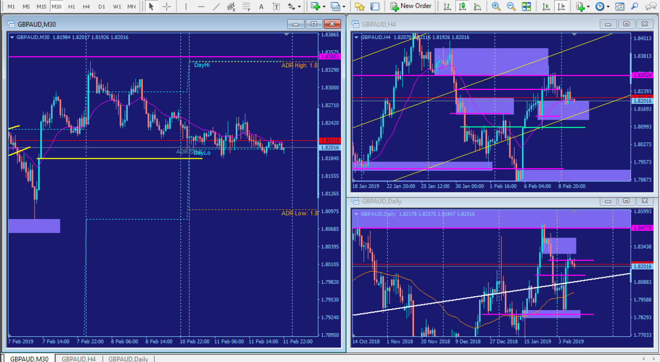
Multiple Frames

Slide 5
Intraday Fundamentals
Price was grinding slowly into Wednesday possibly creating a corrective pattern for a Wednesday reversal.
Price reacted to the low of day Tuesday

Slide 6
Technical Analysis
Price reacted to the small pocket of demand created on Tuesday, heading into Asian session on Wednesday. I didn’t see any strong signs of support but did mark the level where price previously acted upon.

Slide 7
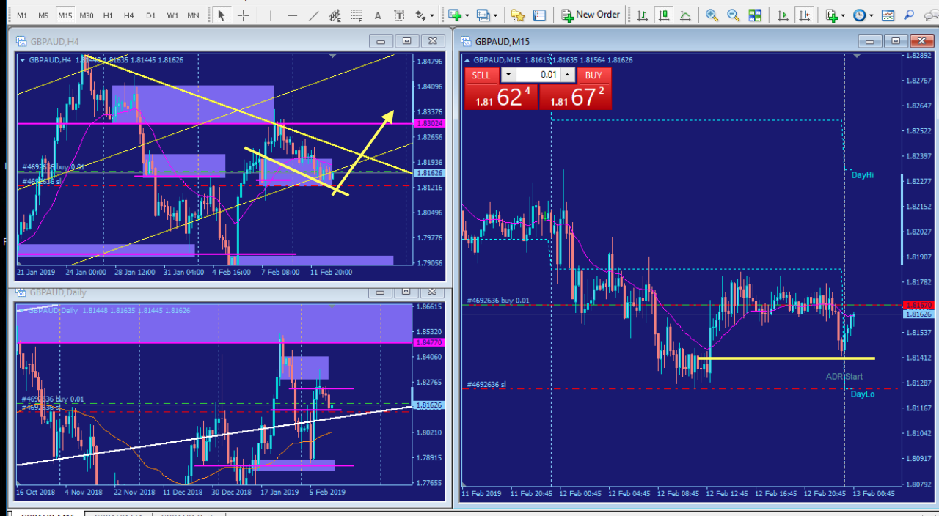
Possible correction/reversal

Slide 8
Trade Management
Mark up the chart of the trade intraday: I took multiple trades on this pair in both directions. The first was the long on Wed, and when it immediately failed to the down side I prematurely took a scary short position but I quickly exited thereafter due to not having my stop placed behind an edge. Because of the grinding patterns it was hard to see any clear edges anywhere except on the higher time frames.
On Thursday I seen a pattern I’ve come to call a “Z” formation push and from my experience they usually make a move so I entered another short position but couldn’t hold on to the move, I let the retracement get me out.

Slide 9
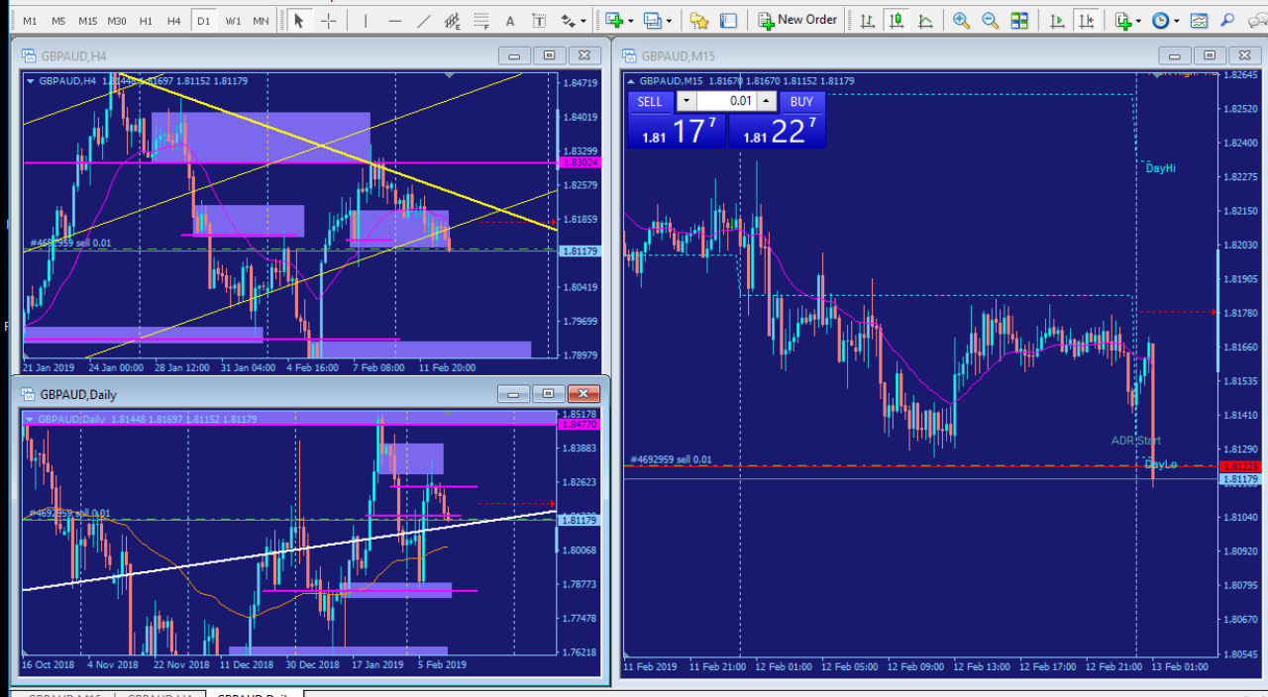
Wednesday scary short

Slide 10
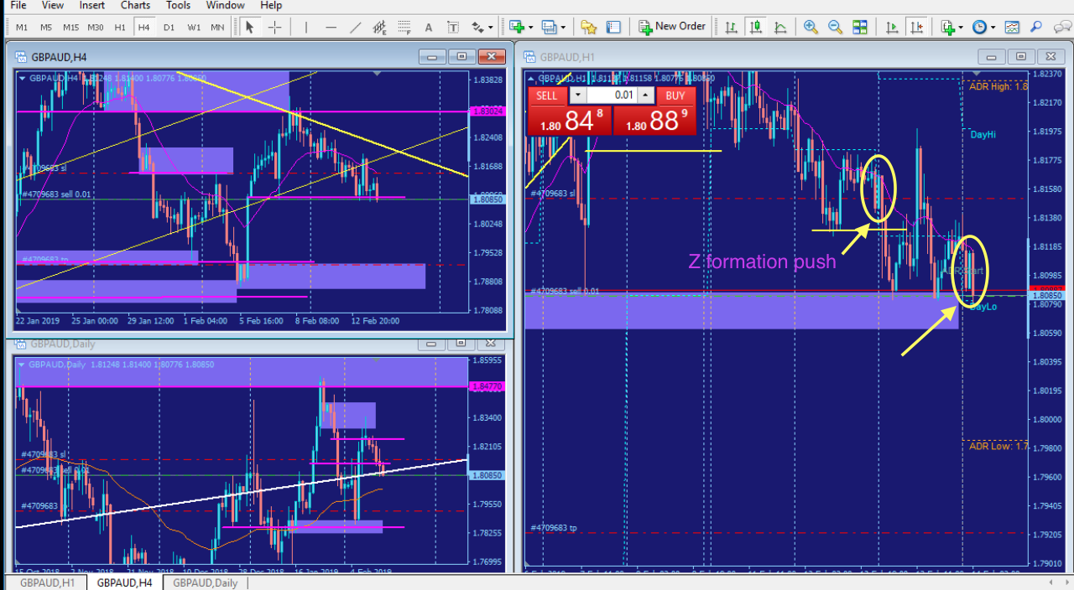
Thursday Z formation

Slide 11
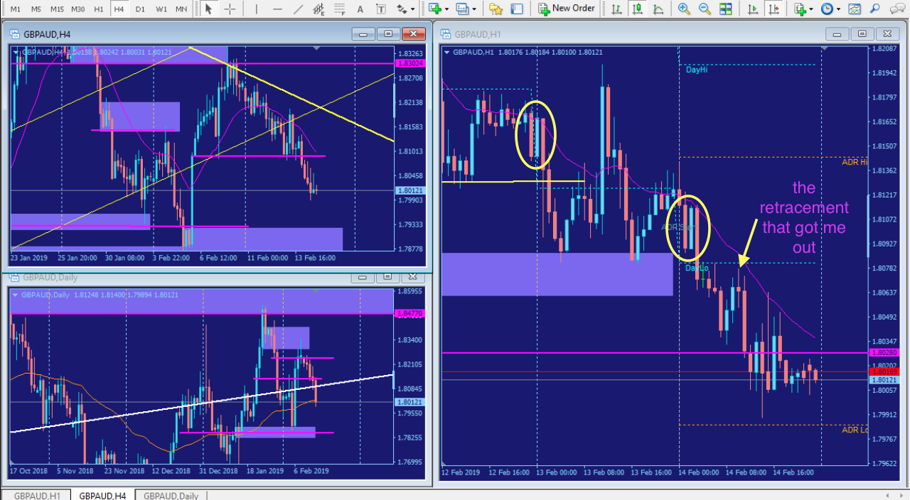
Scared exit

Slide 12
Trade Review
What did you learn from this trade? How could you have done better? How would you trade this differently for the next trade?
If I would have entered my higher time frame A+ trade on Friday or so when price bounced off the 240 supply zone I wouldn’t have fought my way into this slow grinding week. This is exactly why you’re focusing on your monthly goal, to get consistent at entering the trades that work the best for you.
To put your doubts and fears behind you is why you’re doing these exercises, to get proficient at trading what makes the most sense to you.
Solution: keep practicing, keep building your playbook, you don’t know what’s going to happen in the market but you do know what your best setups look like, so keep practicing to enter those and only those.

Slide 13
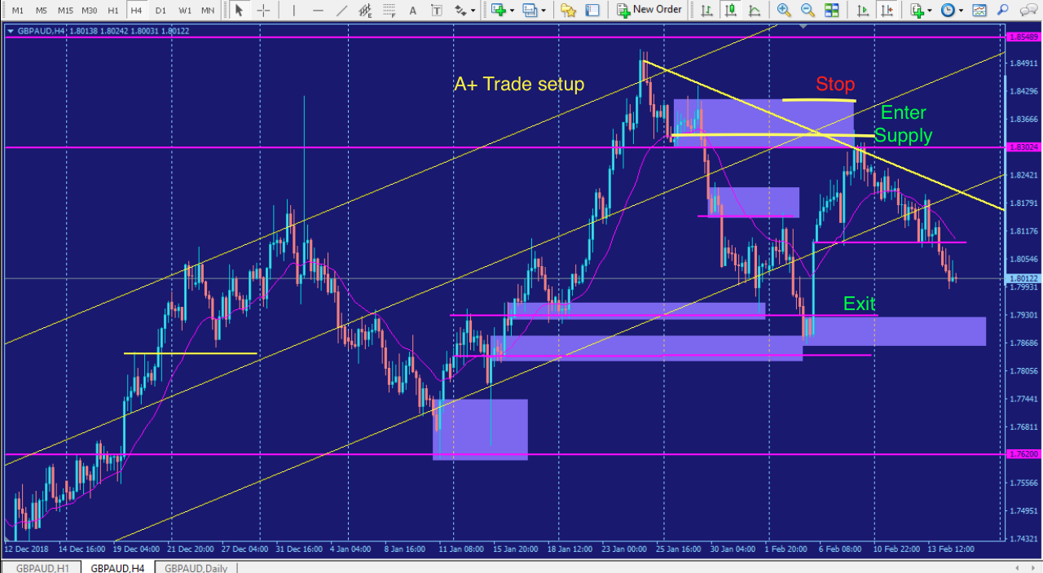
A+ Trade Setup

