Slide 1

Blue Sage Capital
Flag Continuation
Fxdisciple
USD/JPY
Best Practice Trade (Feb 10 2019)

Slide 2

Intraday Fundamentals
Start of a new week and price has been consolidating for the whole of last week. It’s being held by a strong support of buyers pictured as an authentic level.

Slide 3
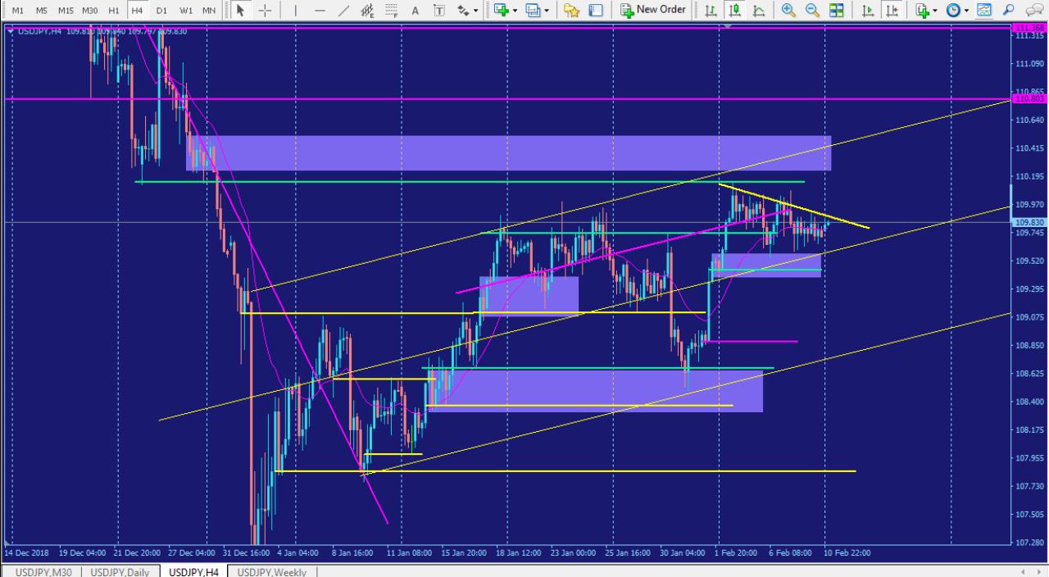
Forming Flag pattern

Slide 4
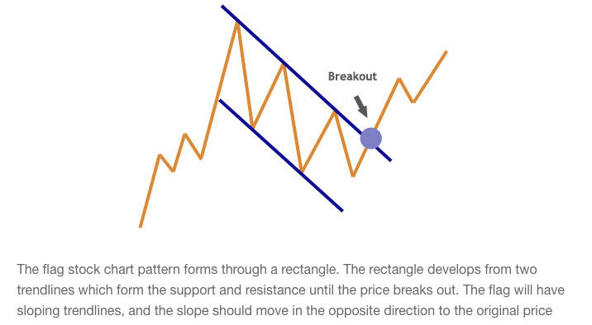
Flag Pattern

Slide 5
Technical Analysis
A flag pattern is emerging on the 240 chart. The next technical level is around 110.410
The pitchfork trend is holding.
The next technical level is also an area of supply, possibly scoring a strong significant zone seen on both the Daily and 240.

Slide 6
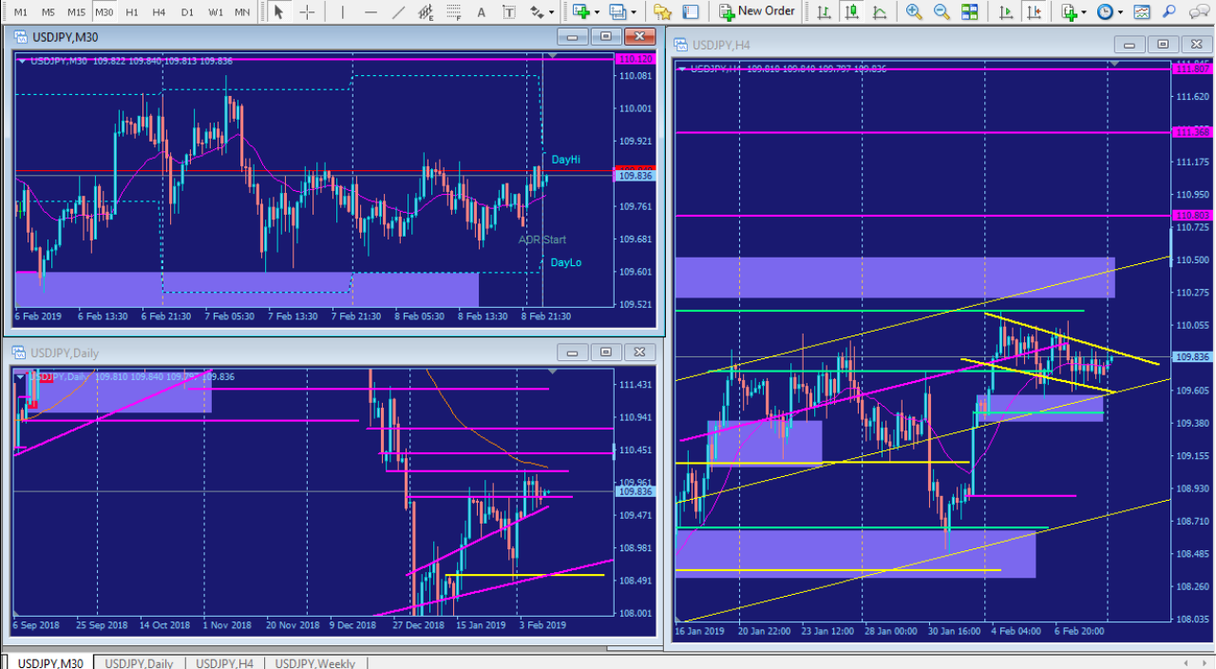
Multiple Time Frame Analysis

Slide 7
Trade Management
Mark up the chart of the trade intraday: Demand zone entry
Where would you add size? The first area I would add size is where price created a consolidation with a pocket of buyers holding the level. The second place I would add is on the retracement, as price slowed down due to lack of volume and picking back up in US session.
Where was your initial stop? Did you adjust your stop as the play developed? If so, why did you adjust your stop? My stop would be below the demand zone of my entry and I would adjust my stop behind each pocket of buyers on the way to my target.
Where did you take profits? How do you pick your profit targets? I would take profits as price hit the next technical level that could cause price to reverse.

Slide 8
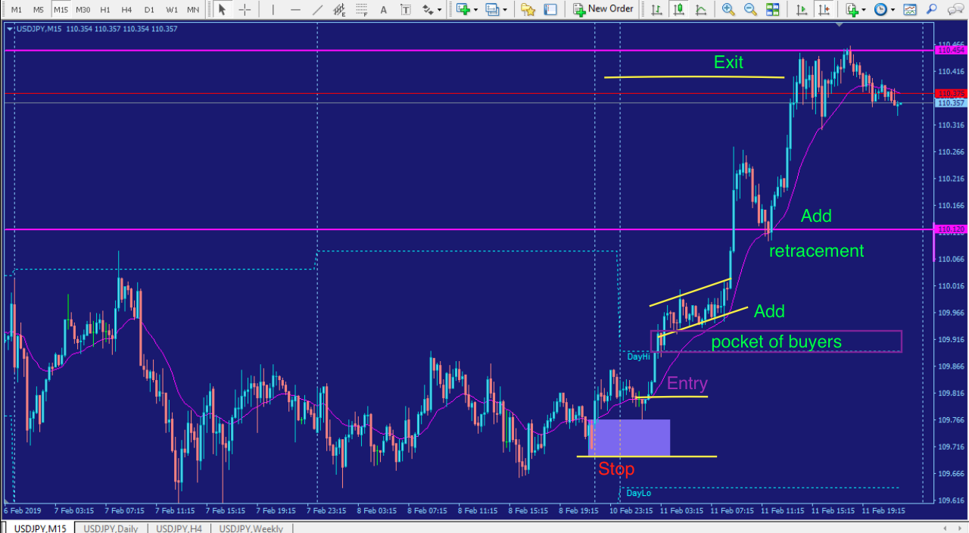
The Trade

Slide 9
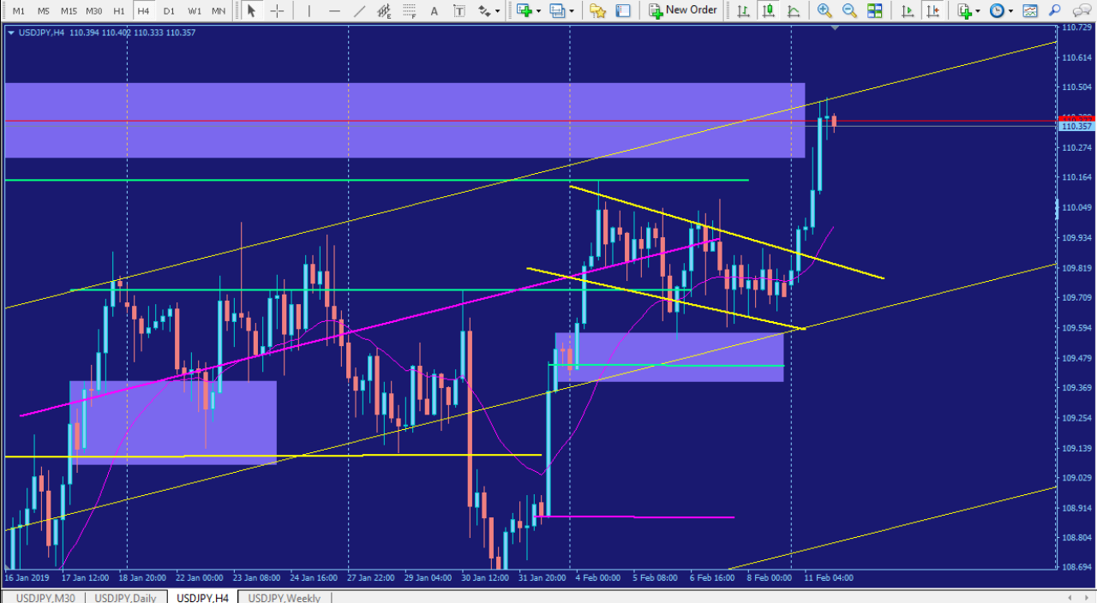
240 view

Slide 10
Trade Review
What did you learn from this trade? How could you have done better? How would you trade this differently for the next trade? I initially didn’t trade this because it was a holiday in Japan. But I’m beginning to notice it really doesn’t matter if there was a holiday or not. If the pattern is there, it usually plays out regardless of the holiday.

