Slide 1

Blue Sage Capital
MM trap move
FXdisciple
GBP/CAD
Date of Trade (Feb 7th)

Slide 2

Big Picture
Price is in a pitchfork ranging trend. The same pattern on the long side in January is similarly playing out now.

Slide 3
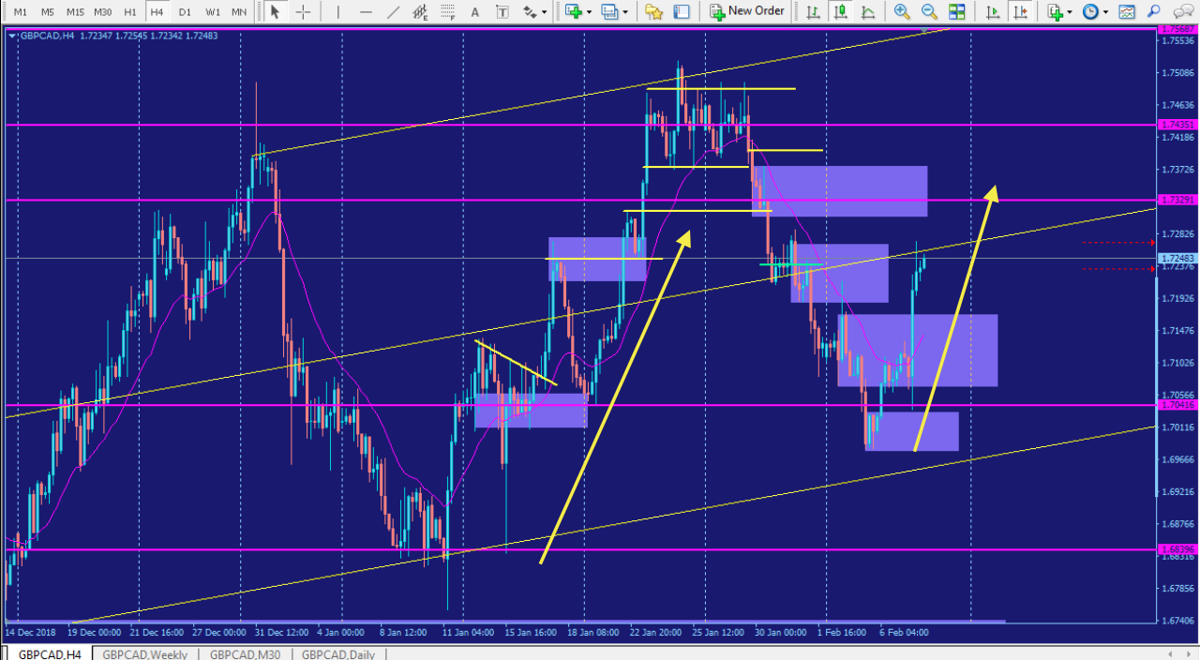
Pitchfork Trend

Slide 4
Intraday Fundamentals
It’s Friday and price has extended into some possibly significant Supply zones also near the pitchfork median line

Slide 5
Technical Analysis
Price has just made the high of the day reacting positively against the current supply zone.

Slide 6
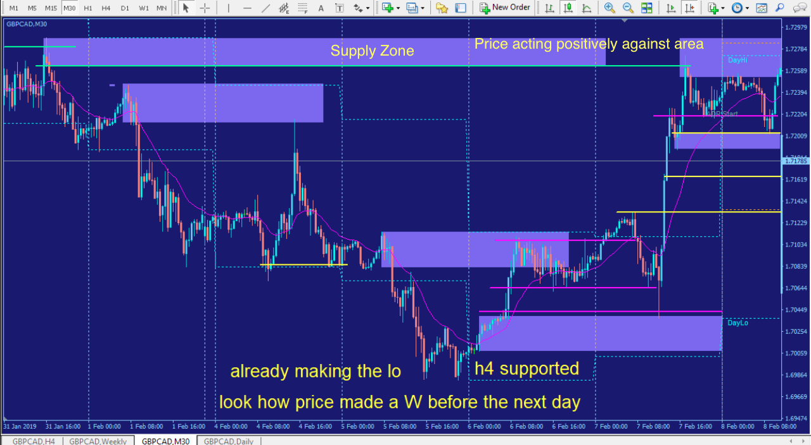
Positive Behavior

Slide 7
Trade Management
Mark up the chart of the trade intraday:
  Entry 1.7242
  Stop 1.7284
  Exit 1.7198
Where would you add size? After the pullback to the Previous Daily high crossing my first entry point, before shifting out of the zone
Where was your initial stop? Above the Previous Daily High and Supply Zone. Did you adjust your stop as the play developed? If so, why did you adjust your stop? I moved my stop to just after break even during early US session.
Where did you take profits? I took unplanned profit. How do you pick your profit targets? Significant opposing levels

Slide 8
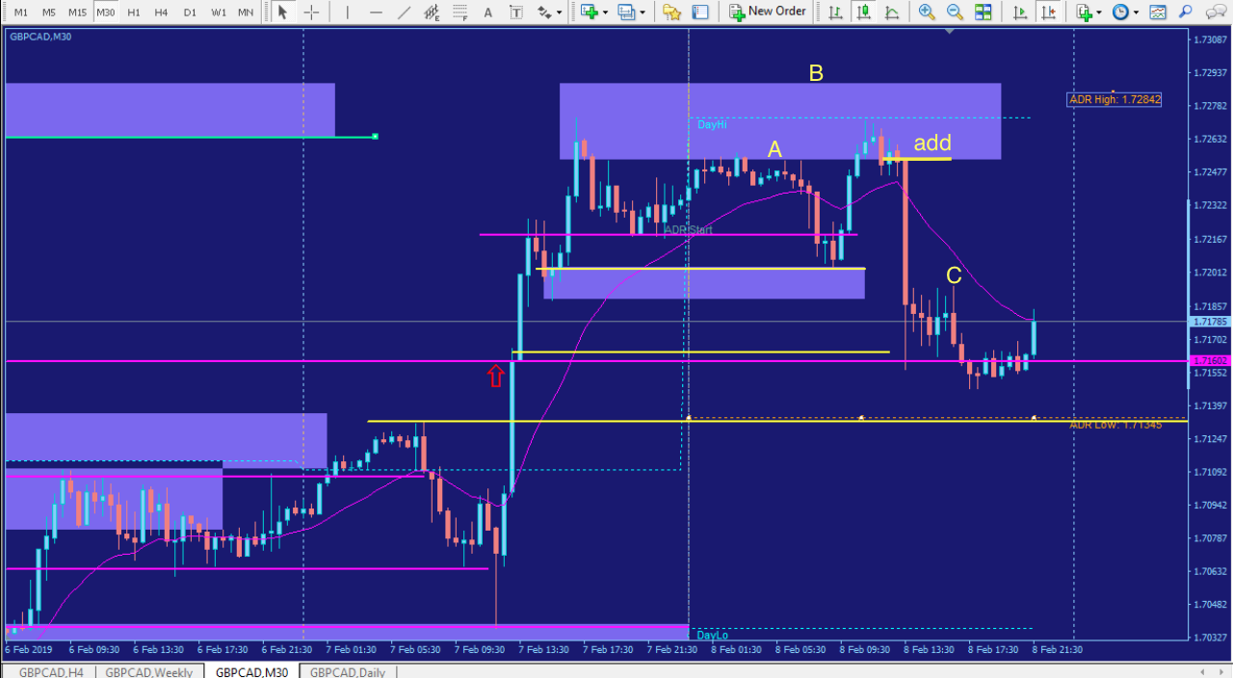
The Trade

Slide 9
Trade Review
What did you learn from this trade? How could you have done better? How would you trade this differently for the next trade?
I need to consider all the variables concerning specific strategies and not overlook them in favor of my bias. Here I overlooked the M formation because price has previously reacted to the authentic level heading into Asian session. I assumed price wouldn’t come up against any resistance heading down. Instead I should have just marked the level and prepare for action if it did. This way if I was in front of the screen I could have acted appropriately and added to the position as price was forming another edge pattern giving me more confidence in the trade. My exit strategy was lacking. I didn’t have one. Again my bias was saying let it run. I should have prepared properly by setting a target at the demand break around 1.71602. As I seen price in the consolidation in US session, I was anticipating a break out of that range and then I would exit after the break of the consolidation. Instead I observed price on the 5m chart from my phone at work and got scared out of the trade as price was heading higher. My intuition said hold but fear won because I didn’t have a solid plan. Set all three at once. Stop, entry, target. Make a checklist for it. Part of your daily report card

Slide 10
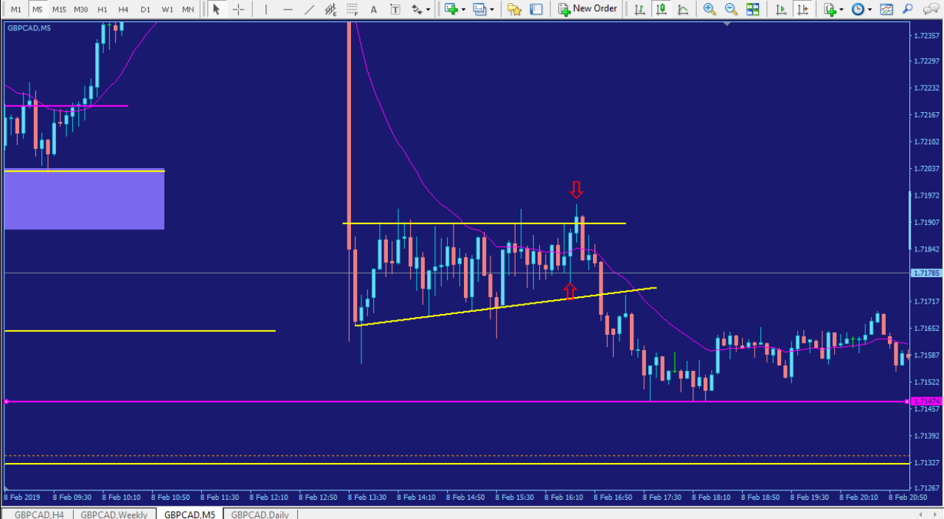
Scared, Exit stage left

Slide 11
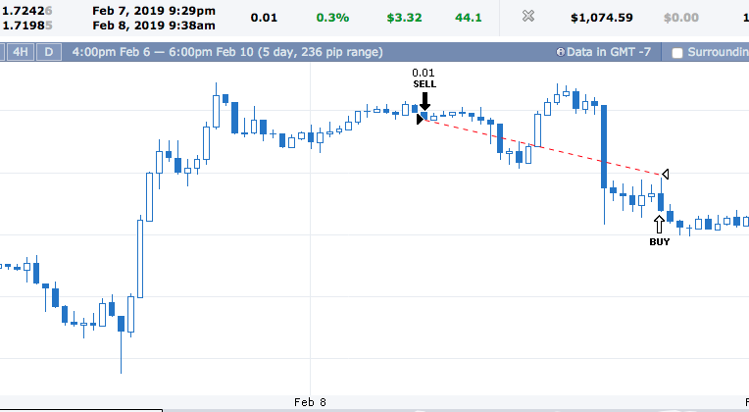
https://www.forexfactory.com/ylk#acct.30-tab.list-ticket.4665351

