Slide 1

Blue Sage Capital
Supply Zone Wycoff
FXdisciple
USD/CAD
Date of Trade (Dec 27/2018 and Jan 25/2019)

Slide 2

Big Picture
Large time frame charts are showing clear strong edges for potential shorting opportunities.
The first significant trade on Dec 27th is based off a strong Supply Zone from the weekly chart
While the second significant trade on Jan 25th is showing confirmation on both the Daily and 240 timeframes

Slide 3
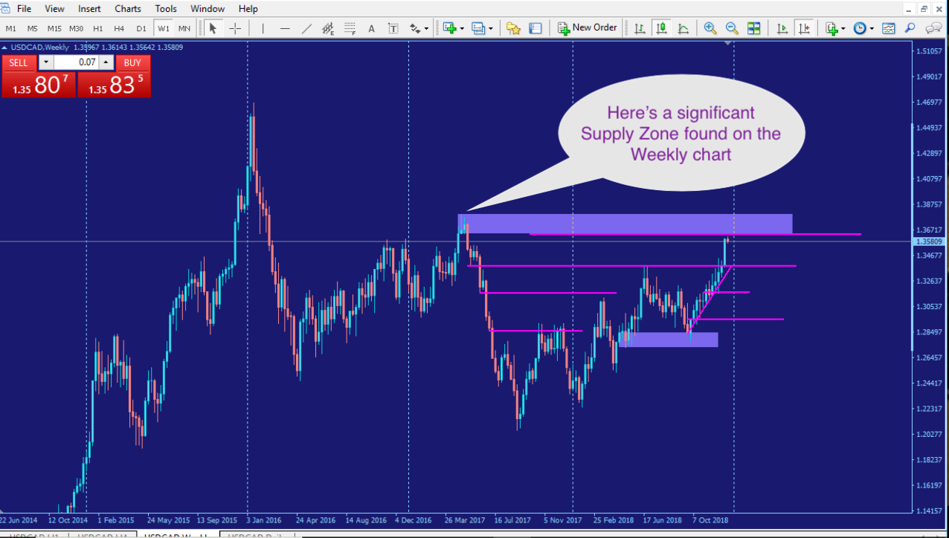
Dec 27th trade

Slide 4
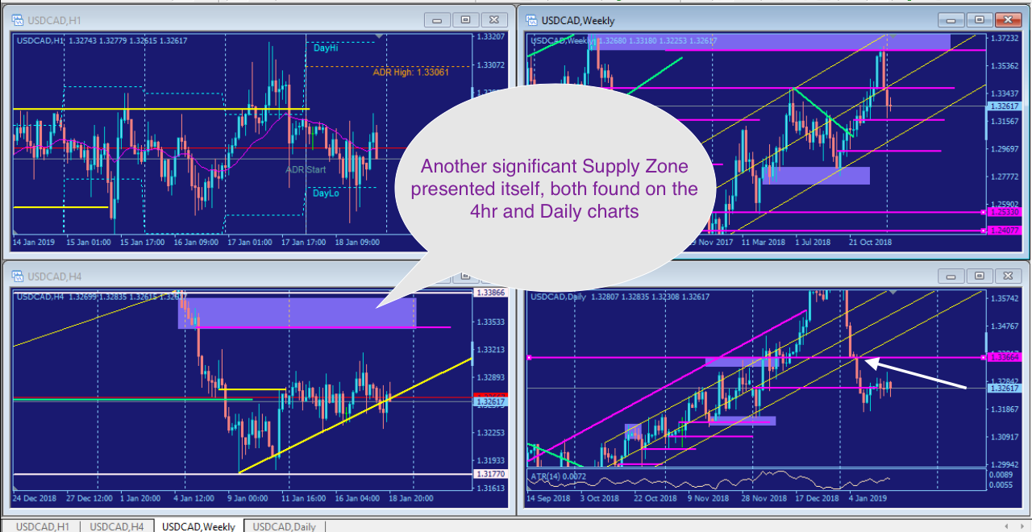
Jan 25th trade

Slide 5
Intraday Fundamentals
For the first trade on Dec 27th it was the holiday week after Christmas and before New Years. So you expect price action to be slow and consolidate throughout the week.
The Jan 25th trade was heading into the Market Makers Friday cycle which means a high probability reversal is in order.

Slide 6
Technical Analysis
Dec 27th – 4hr chart-Price action was showing clear signs of slowing down heading into the Weekly Supply Zone. Although it hadn’t shown clear signs of price action reversing, the Wycoff pattern was presenting itself while showing no strong signs of demand or buying pressure from the bottom.
Jan 25th - 4hr chart – Price action was showing signs of slowing down with a slight Wycoff pattern/consolidation. While the Daily chart was showing clear signs of a correction pattern indicating a possible reversal.

Slide 7
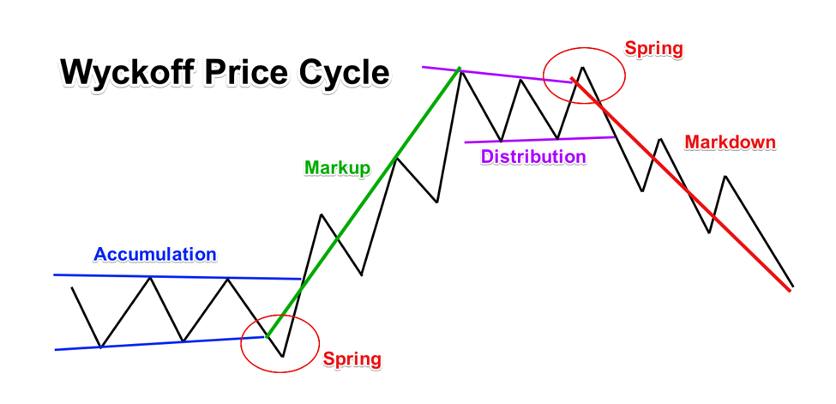

Slide 8
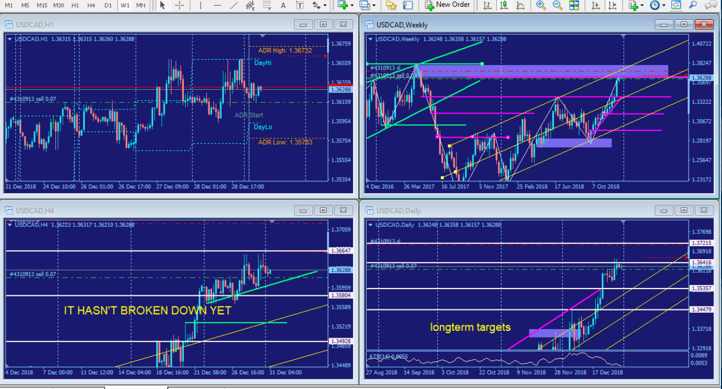
Dec 27th trade

Slide 9
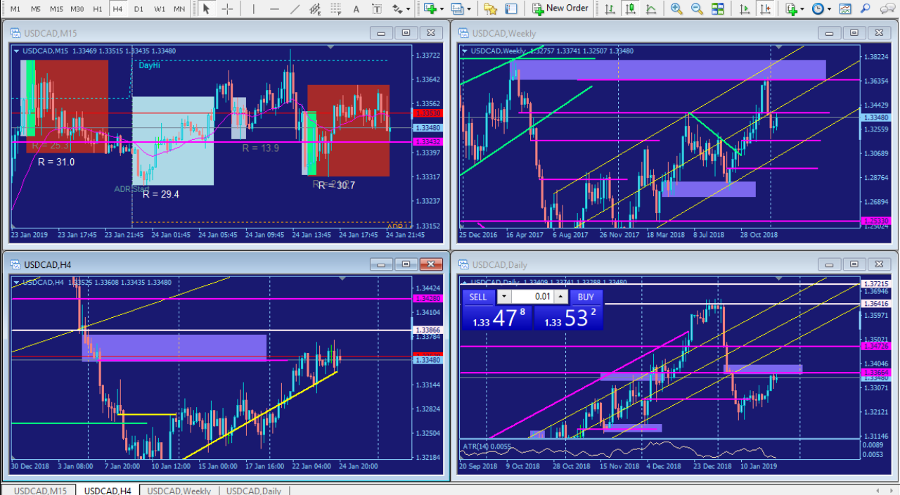
Jan 25th trade

Slide 10
Trade Management Dec 27th
Mark up the chart of the trade intraday:
  Entry
  Stop
  Exit
Where would you add size? Either a shift out of the zone or at a correction consolidation.
Where was your initial stop? Did you adjust your stop as the play developed? If so, why did you adjust your stop? I would adjust my stop behind supply and demand market structure levels
Where did you take profits? How do you pick your profit targets? I pick my targets based on opposing technical levels where price can potentially reverse from.

Slide 11
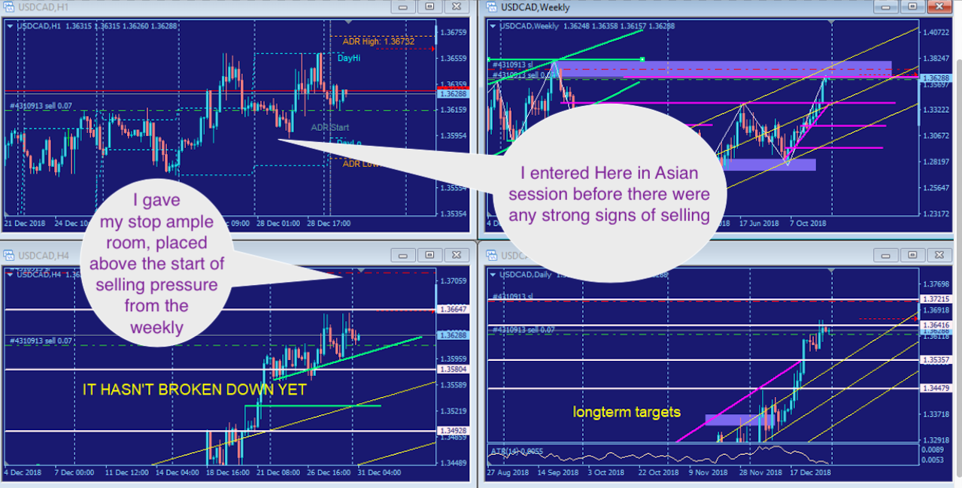
Dec 27th trade

Slide 12
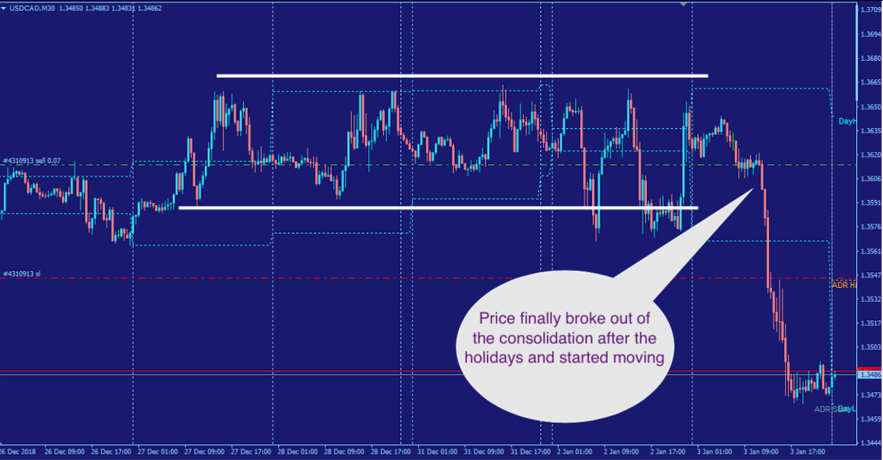
Dec 27th trade

Slide 13
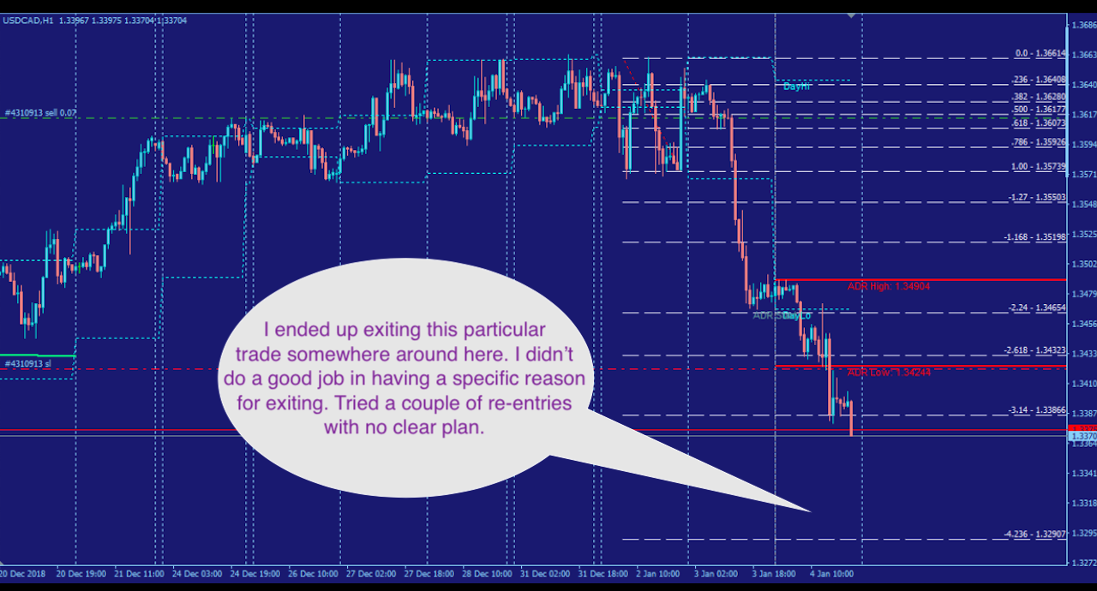
Dec 27th trade

Slide 14
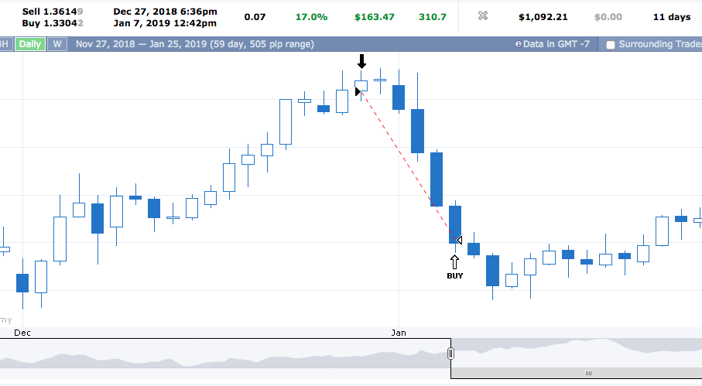
https://www.forexfactory.com/ylk#acct.30-tab.list-ticket.4310913

Slide 15
Trade Review
What did you learn from this trade? That I could trade nice moves like this. How could you have done better? I could have added at predetermined areas, and picked a specific target to know where I should be thinking about exiting the trade. How would you trade this differently for the next trade? I would predetermine where I would add to the position and pick a target to know where I should be exiting the trade.

Slide 16
Trade Management Jan 25th
Mark up the chart of the trade intraday:
  Entry
  Stop
  Exit
Where would you add size? Either a shift out of the zone or at a correction consolidation.
Where was your initial stop? Did you adjust your stop as the play developed? If so, why did you adjust your stop? I would adjust my stop behind supply and demand market structure levels
Where did you take profits? How do you pick your profit targets? I pick my targets based on opposing technical levels where price can potentially reverse from.

Slide 17
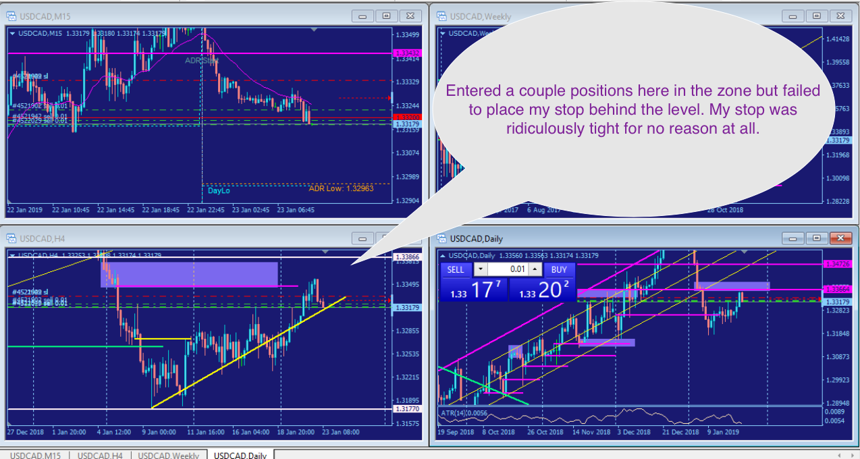
Jan 25th trade

Slide 18
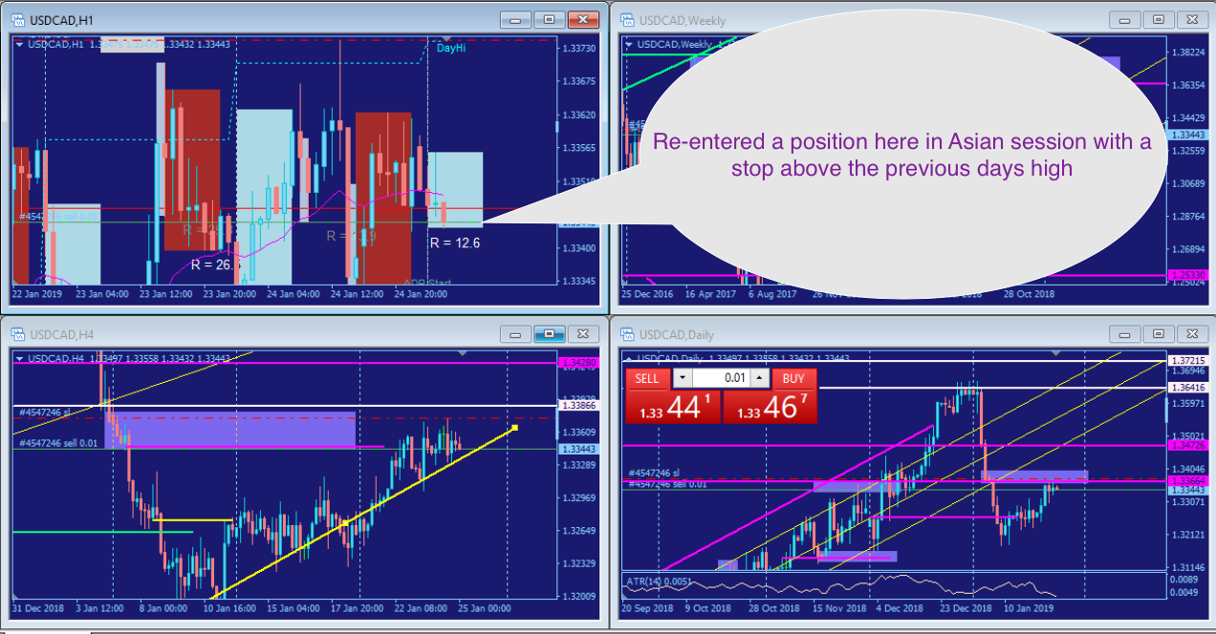
Jan 25th trade

Slide 19
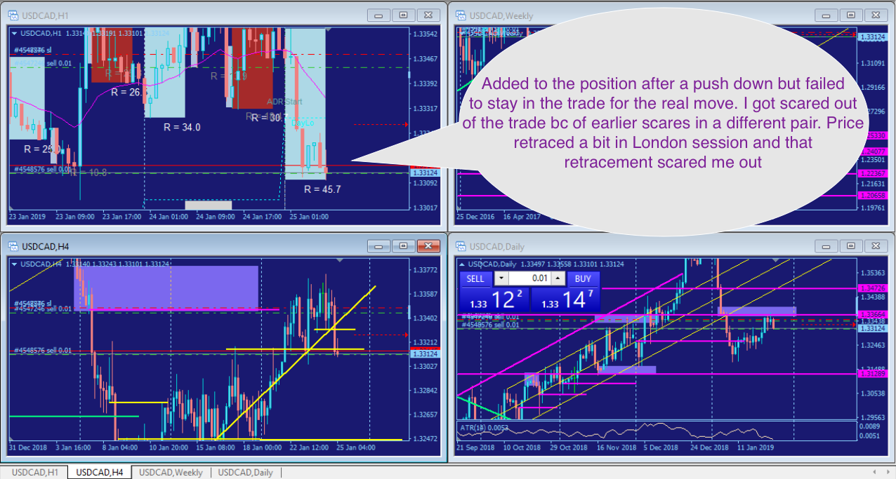
Jan 25th trade

Slide 20
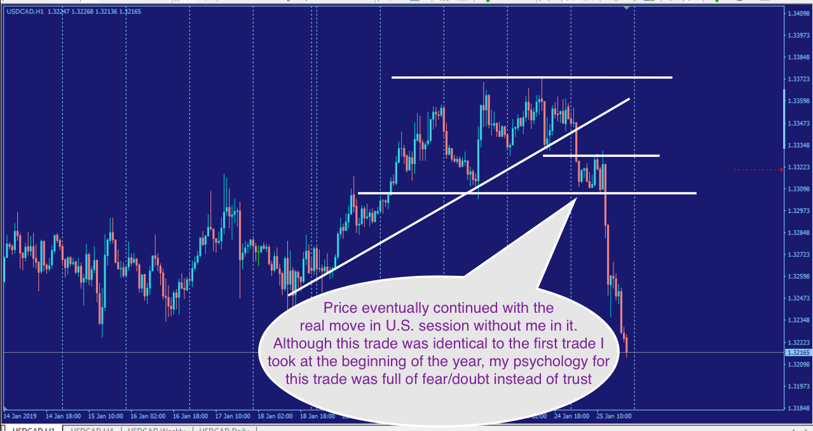
Jan 25th trade

Slide 21
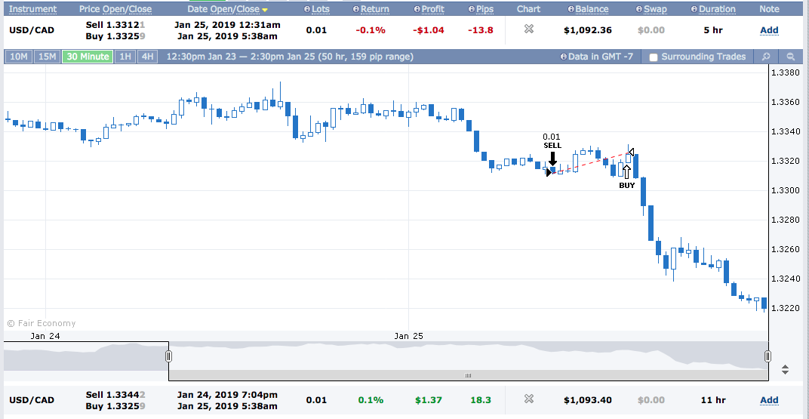
https://www.forexfactory.com/ylk#acct.30-tab.list-ticket.4548576

Slide 22
Trade Review
What did you learn from this trade? I need to have patience in allowing the patterns to fully present themselves. I need to give my stops room, placing them behind market structure/significant levels (where if price were to retest, it would not break the level. How could you have done better? I could have allowed my edges to play out, pick a specific target so I know why I’m in the trade preventing me from getting scared out of trades. How would you trade this differently for the next trade? I would place my stops in their appropriate places, pick my targets so I know where I should be thinking about exiting, and trusting my edges because they’ve been proven to work.

