Slide 1
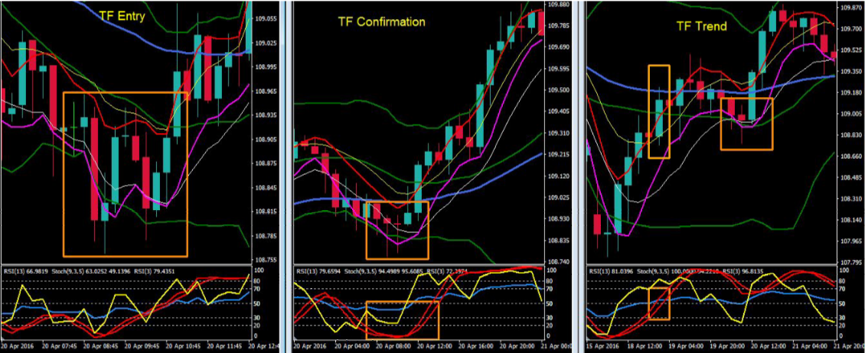
Re-entry 1 – Setup

Slide 2
Information; Re-entry 1
TF Trend
CSD as signal and then Re-entry
CS retesting and closing above MA5/10 and mid BB, RSI13 has to be located above level 50
TF Confirmation
Extreme buy signal
RSI3 below level 30
Stoch935 below level 20
RSI3 will be above the stoch935
Entry TF
Extreme signal
RSI13 & RSI3 will be below level 30
RSI13 will be above stoch935
TP TF
TP1 when stoch935 reach level 70 on TF entry
TP2 when stoch935 reach level 70 on TF confirmation

Slide 3
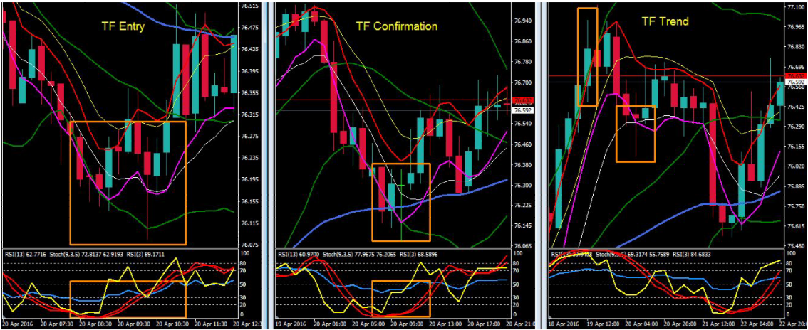
Re-entry 2 - Setup

Slide 4
Information; Re-entry 2
TF Trend
There’s CSM closed outside the BB
CS retest and close above MA5/10 creating Re-entry
TF Confirmation
Extreme buy signal
RSI3 below level 30
Stoch935 below level 20
RSI3 will be above the stoch935
Entry TF
Extreme signal
RSI13 & RSI3 will be below level 30
RSI3 will be above stoch935
Enter on Extreme or MLV
TP TF
TP1 when stoch935 reach level 70 on TF entry
TP2 when stoch935 reach level 70 on TF confirmation

Slide 5
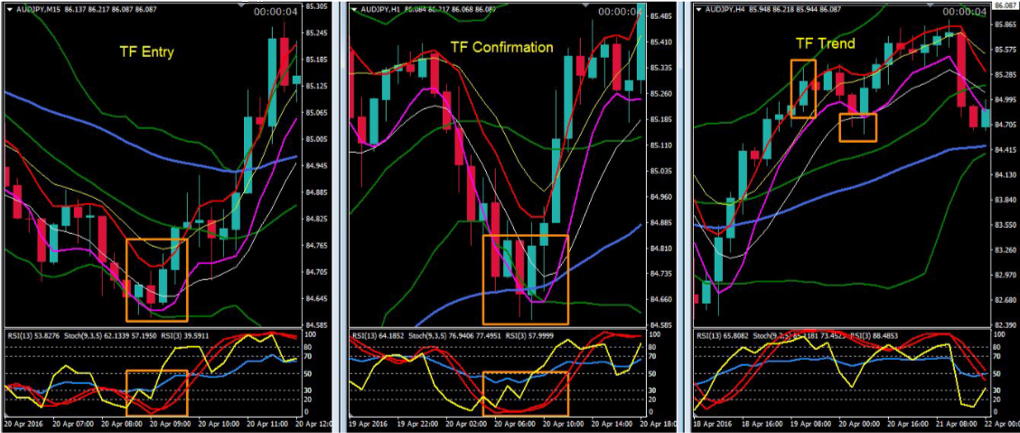
Re-entry 3 - Setup

Slide 6
Information; Re-entry 3
TF Trend
CS closing above/outside MA5, RSI13 has to be above level 50
Re-entry
TF Confirmation
Extreme buy signal
RSI3 below level 30
Stoch935 below level 20
RSI3 will be above the stoch935
Entry TF
Extreme signal
RSI13 & RSI3 will be below level 30
RSI3 will be above stoch935 and stoch935 will be below level 20
Enter on Extreme
TP TF
TP1 when stoch935 reach level 70 on TF entry
TP2 when stoch935 reach level 70 on TF confirmation

Slide 7
Conclusion…
Trading is all about Probability, doing a Strategic analysis before taking any trade in the market. Wait for confirmations, signal and setups when you’ve done your best analysis. Try to be “patient, patient and patient enough, and then when you see the setup, pull the trigger.”

