Slide 1

Authentic zone w/trend
Fxdisciple
GBP/JPY
Date of Trade (AUG 9, 2018)

Slide 2

Big Picture
The pair has been in a down trend for over a month starting from a double top or M formation.

Slide 3
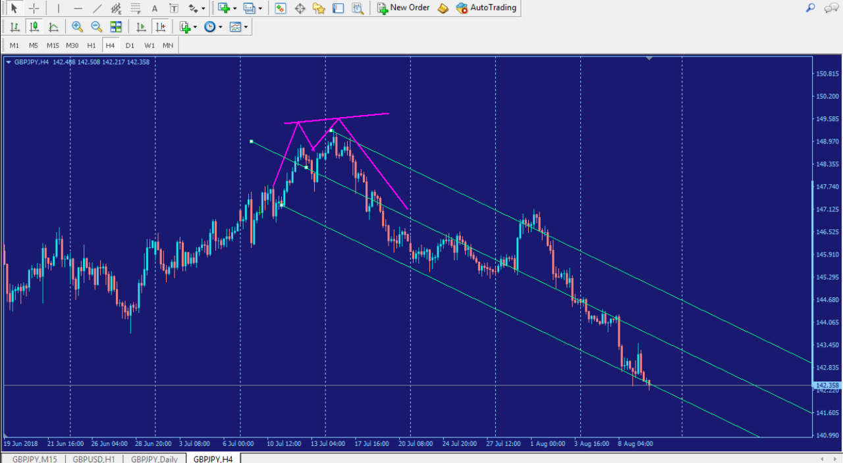
Trend within Market Geometry

Slide 4
Intraday Fundamentals
Price just kept moving down. It was pause and have some buyers during Asian session just to get into position for further moves downward.

Slide 5
Technical Analysis
An authentic zone, going with the trend was formed on Wed. Price got into position during Asian session to enter the London volume to continue with the trend.
A reversal candle was found on two different time frames inside the authentic zone.

Slide 6
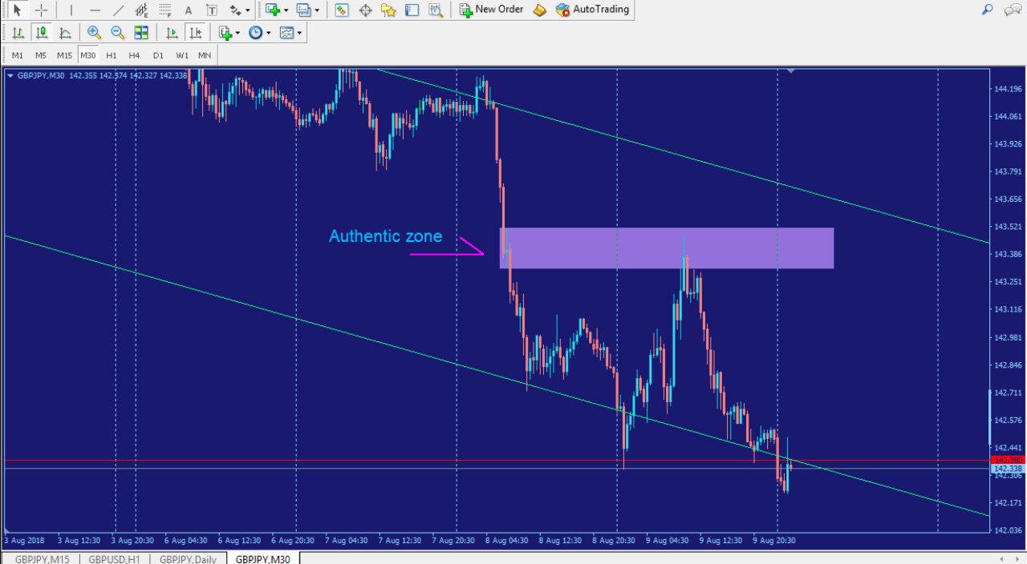
Authentic Zone

Slide 7
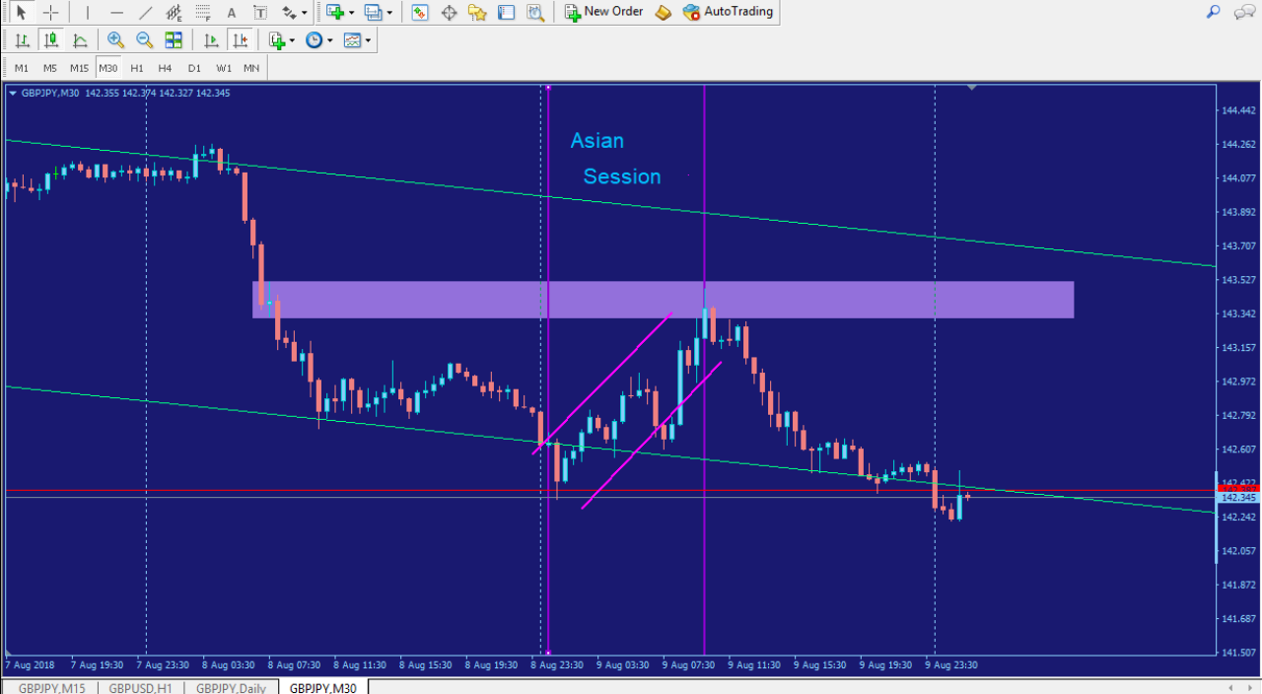
Asian Session, inducing buyers

Slide 8
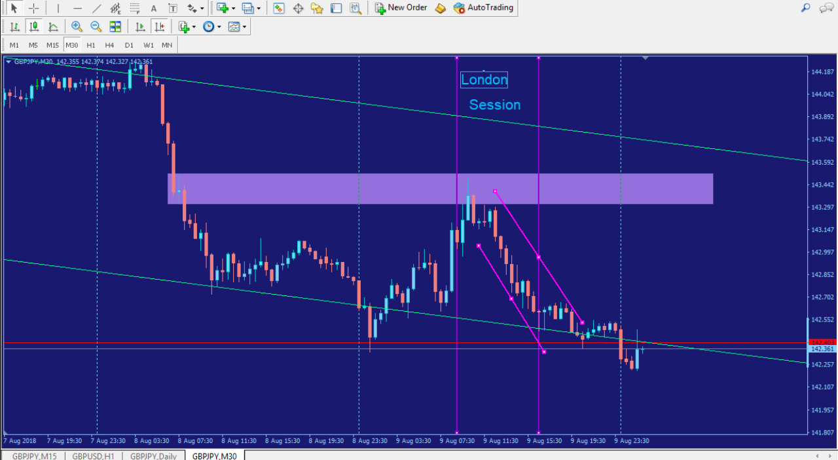
London Session, taking it right back with trend

Slide 9
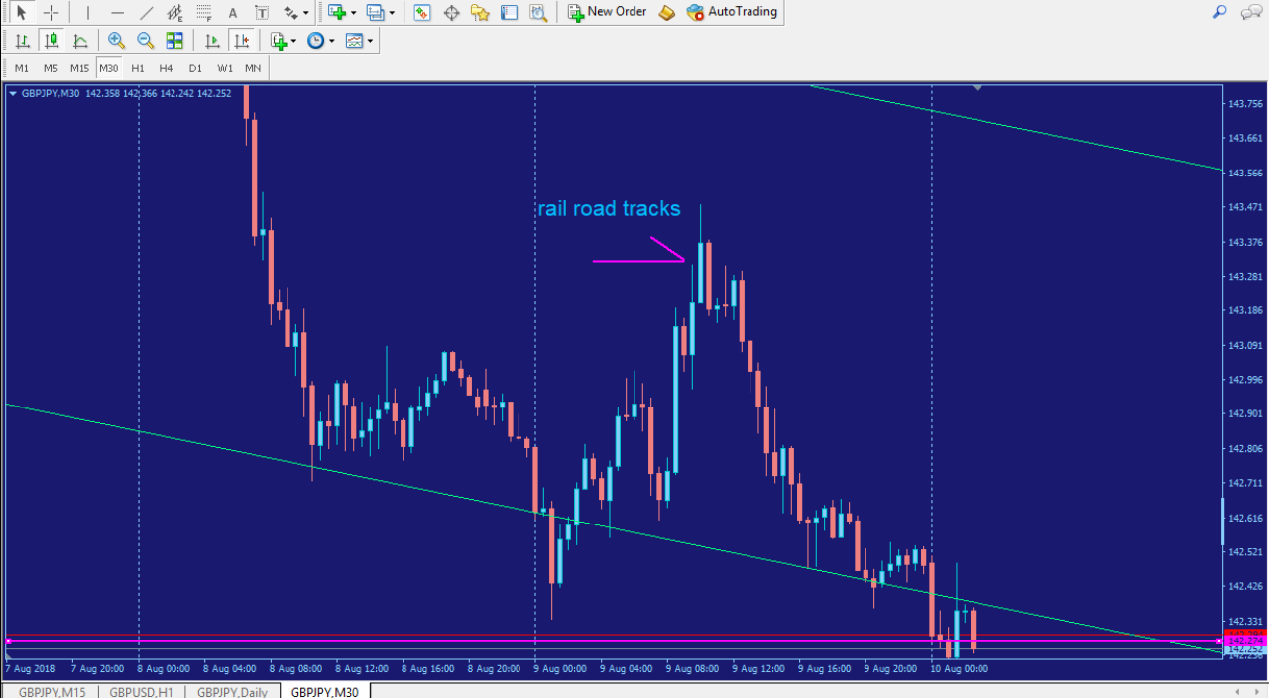
Rail-Road Tracks Reversal Candle

Slide 10
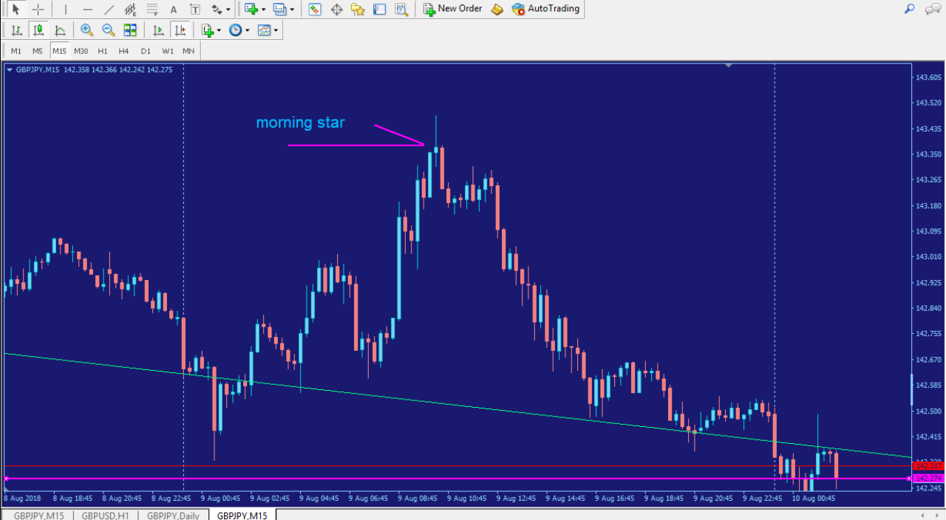
Morning Star Reversal Candle

Slide 11
Reading the Tape
Fill in the details. Anything clear patterns from the tape? Develop the habit of spotting patterns from just the tape that you can trade off of going forward. For example, there was a strongly held bid above a technical resistance level and then the stock was very clean.
* Include tape of the play, cut the tape for the most important parts of the trade to be most efficient for the viewer*

Slide 12
Trade Managment
Mark up the chart of the trade intraday:
  Entry
  Stop
  Exit
Where would you add size? On a pullback.
Where was your initial stop? The previous candle above the zone. Did you adjust your stop as the play developed? If so, why did you adjust your stop? I would move to break even after the pullback continues to my target; so I’m only risking one position at a time.
Where did you take profits? Just above the next opposing demand zone. How do you pick your profit targets? Same as above

Slide 13
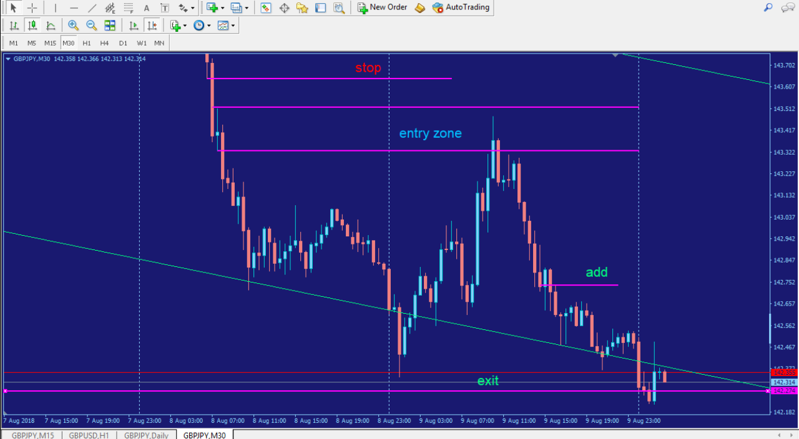
Trade

Slide 14
Trade Review
What did you learn from this trade? I learned to be cognizant about how the sessions can be used to change the direction of a trend. How could you have done better? I need to learn to wait for confirmation before I enter and learn to stay with the trend instead of always looking for the counter trend trade. How would you trade this differently for the next trade? I would let the patterns present themselves before I enter keeping the sessions volume in mind.

