Slide 1
BBMA ZERO LOSS ZONE
BEFORE GOING TO THIS PRESENTATION CHECK
BBMA BASIC VIDEO IN YOU TUBE MANY VIDEOS ARE THERE IN YOUTUBE BUT THIS CHANNEL IS BEST SINCE HE UPLOAD LIVE SEMINAR BY OMA ALLY AND ROOHI AND IT’S THE BEST

Slide 2
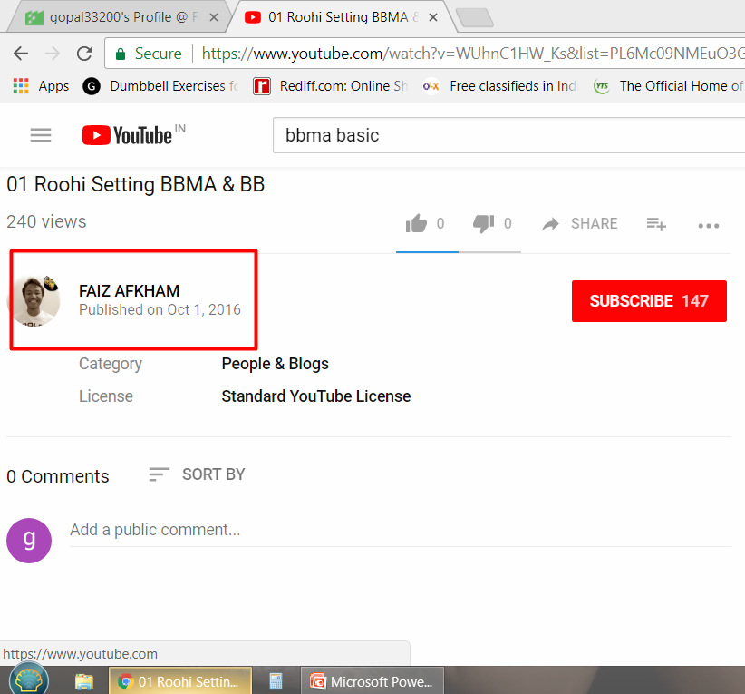

Slide 3
BBMA ZERO LOSS ZONE
12 VIDEOS WILL BE THERE BE PATIENT LISTEN ALL VIDEOS SLOWLY AND THEN READ THIS PRESENTATION WITHOUT KNOWING BASIC YOU CANNOT UNDERSTAND THIS PRESENTATION VIDEOS WILL BE IN MALAY LANGUAGE ONLY BUT YOU CAN UNDERSTAND CHART LANGUAGE SO WATCH IT TILL YOU UNDERSTAND FIRST TIME YOU MAY FEAR AFTER MANY TIME WATCHING YOU GET SOME IDEA

Slide 4
BBMA ZERO LOSS ZONE
SO HOW THE TREND START AND END WATCH BOLLINGER BAND WITH MA 50
BUY EXAMPLE :
WHEN MA 50 TOUCH TOP BOLLINGER BAND TREND IS SLOWING AND AFTER TOUCHING TOP BB IT WILL TOUCH MID BB SO SIDE WAY WILL START AFTER TOUCHING MID BB IT WILL TOUCH LOW BB AFTER THAT OUR ZONE STARTS
SAME REVERSE FOR SELL I WILL SHOW EXAMPLE IN NEXT SLIDE

Slide 5
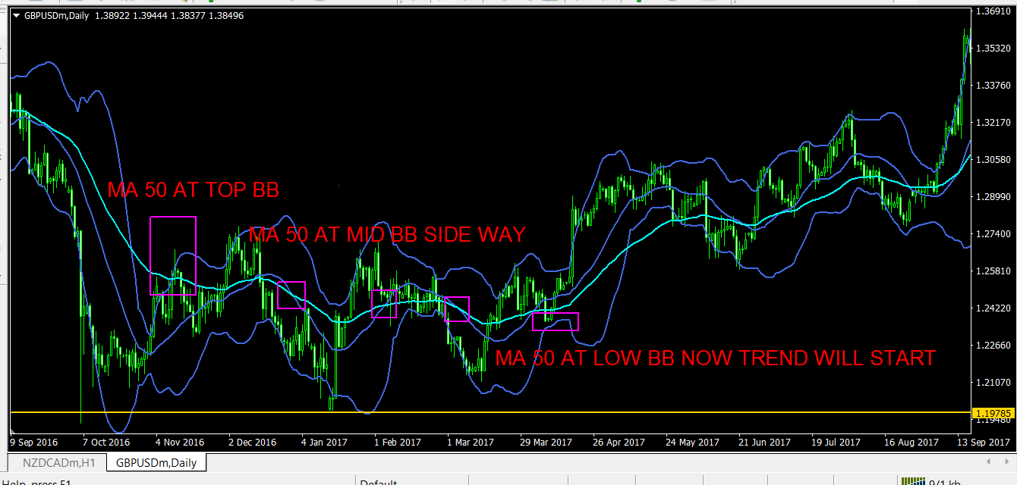

Slide 6
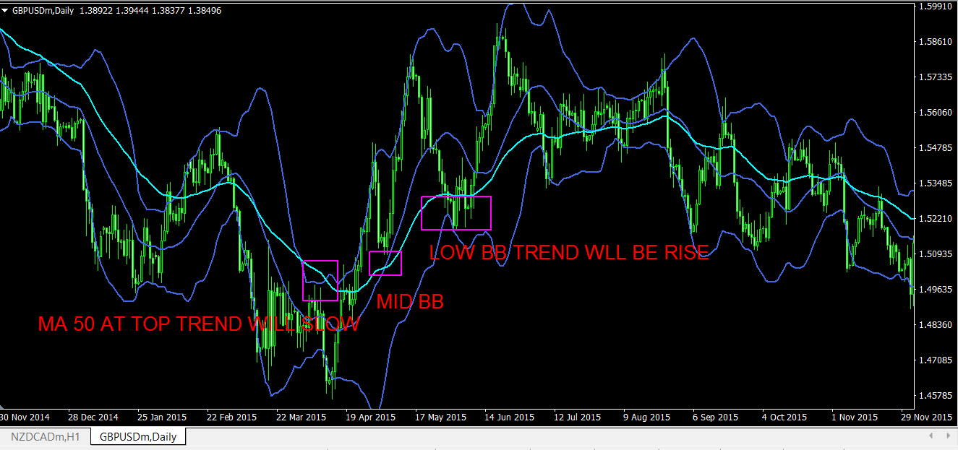

Slide 7
BBMA ZERO LOSS ZONE
MA 50 TRAVELLING TO EACH BOLLINGER BAND PRICE WILL CREATE SIDE WAY ,TREND START AND TREND REVERSAL SO LETS COMBINE WITH BBMA CODE

Slide 8
BBMA ZERO LOSS ZONE
ADD THIS INDICATOR IN SUBWINDOW
RSI 13 DEFAULT SETTING
RSI3 DEFAULT SETTING
STOCHASTIC SETTING CHECK IT IN NEXT SLIDE WITH IMAGE

Slide 9
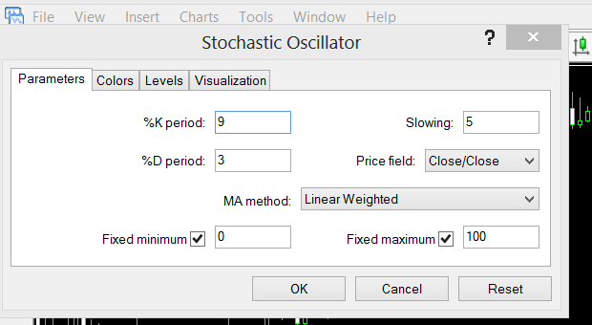

Slide 10
BBMA ZERO LOSS ZONE
YOU MUST CHECK REENTRY IN DAILY AND WEEKLY ONLY NOT IN SMALLER TIME FRAME YOU HAVE 28 PAIRS SO EACH WEEK YOU GET MANY SIGNALS
MY WAY OF SEEING REENTRY IS DIFFERENT CHECK RSI 3 IN DAILY OR WEEKLY IF RSI 3 IS ABOVE 80 LEVEL AND MA50 NEAR THEN IT IS SELL ZONE ONLY

Slide 11
BBMA ZERO LOSS ZONE
If rsi 3 is below 20 and m50 near then it is sell zone ma 50 should be near then it is more valid lets see next slide few example

Slide 12
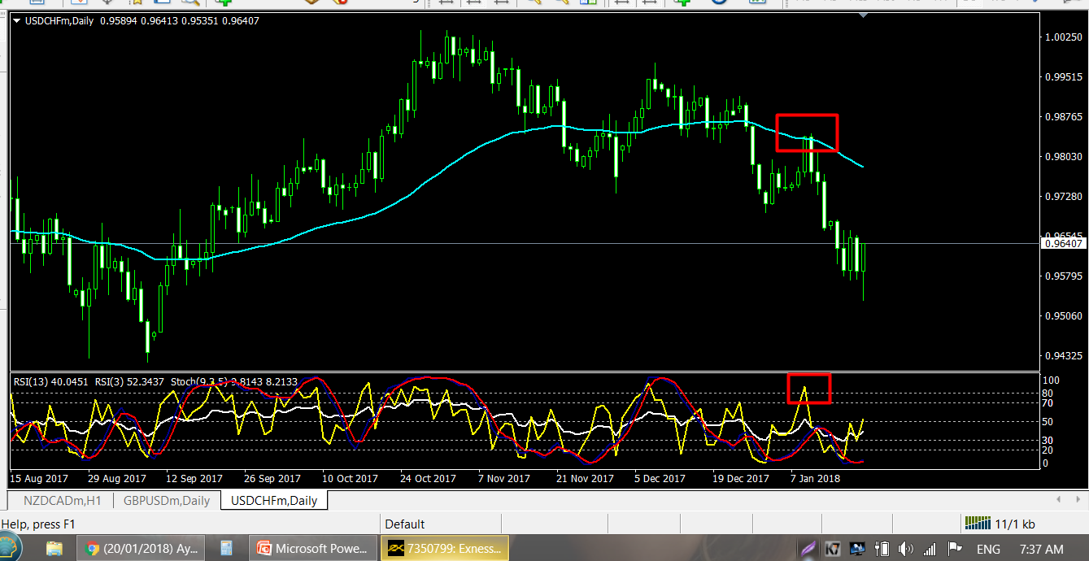
BBMA ZERO LOSS ZONE

Slide 13
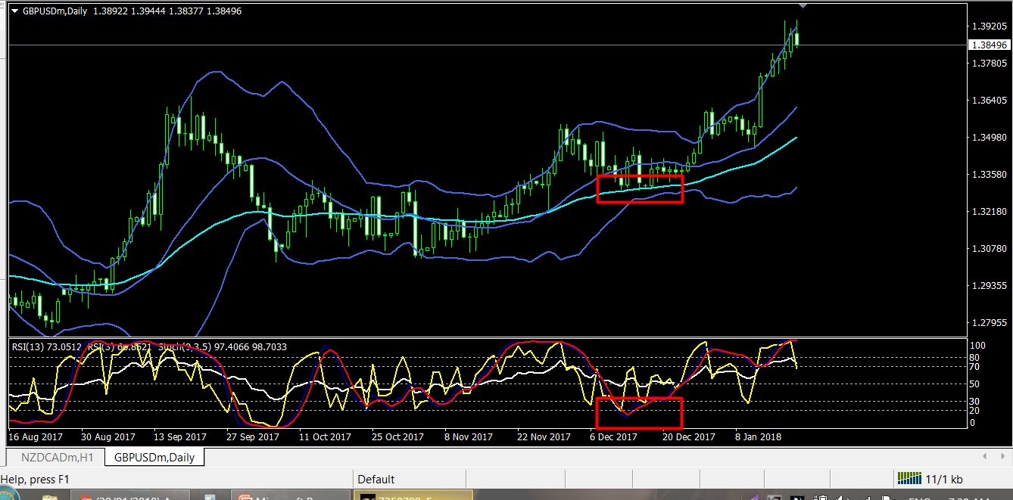

Slide 14
ZERO LOSS ZONE
SOME TIME RSI 3 AND WILLNOT COINCIDE WITH MA 50 IF NOT COINCIDE THEN IT WILL BE AN COUNTER TREND TO TRADE WITH COUNTER YOU NEED SOME EXPERIENCE SO NOW AN BEGINNER YOU TRADE WITH TREND

Slide 15
BBMA ZERO LOSS ZONE
FOR SEE IF RSI 3 ABOVE 80 IN DAILY THEN GO TO H4 CHECK RSI 13 AND STOCHASTIC POSTION IT WILL BE ABOVE 80 IT MEANS PRICE IS IN HIGH LEVEL
REVERSE FOR BUY

Slide 16
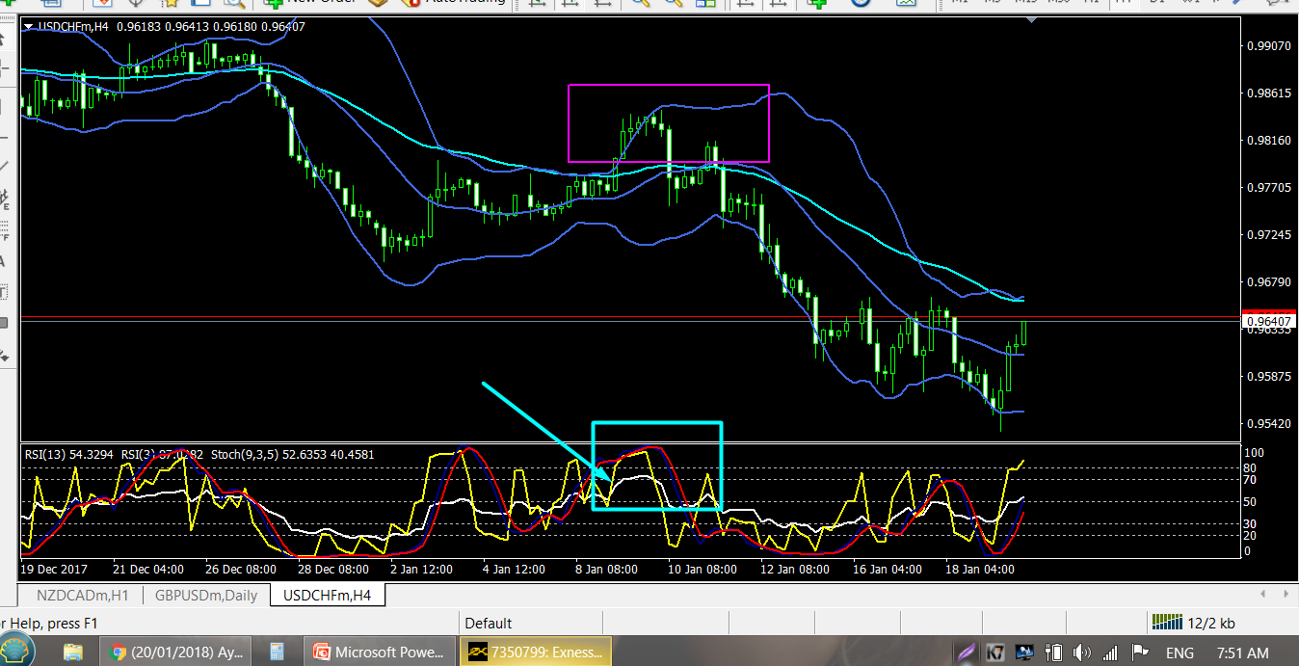

Slide 17
BBMA ZERO LOSS ZONE
NOW WE HAVE HOPE IN REENTRY
SOP FOR BBMA ZERO LOSS ZONE
SELL EXAMPLE
RENTRY IN DAILY (RSI 3 ABOVE 80 NEAR MA50)
EXTREME IN H4 (RSI 13 AND STOCHASTIC ABOVE 80)
CSM IN H1
CHECK MA 50 TRAVELLIN IN M5 OR M15 WHEN PRICE TOUCH TOP BB SELL

Slide 18
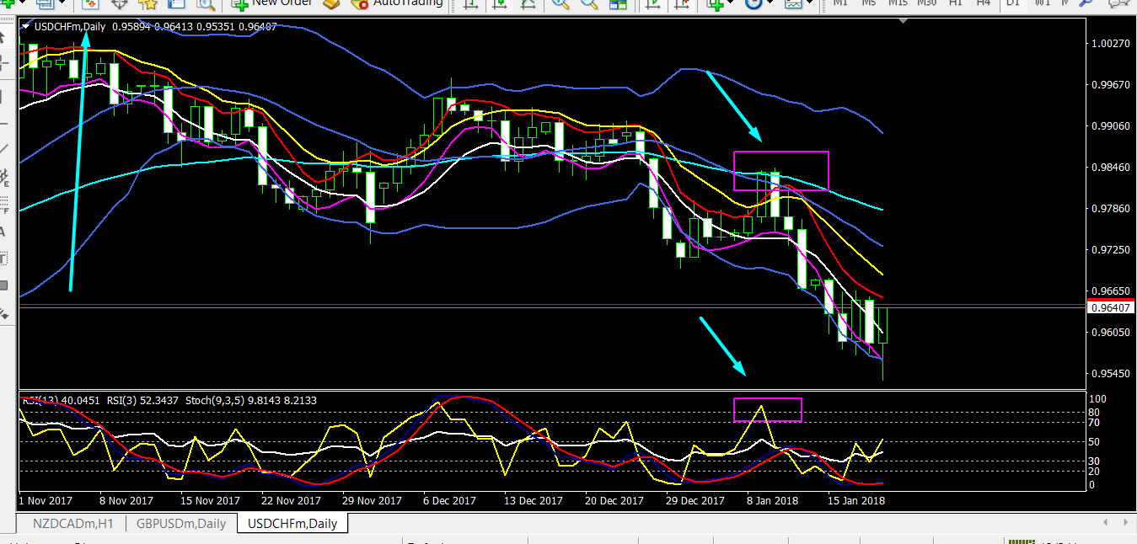

Slide 19
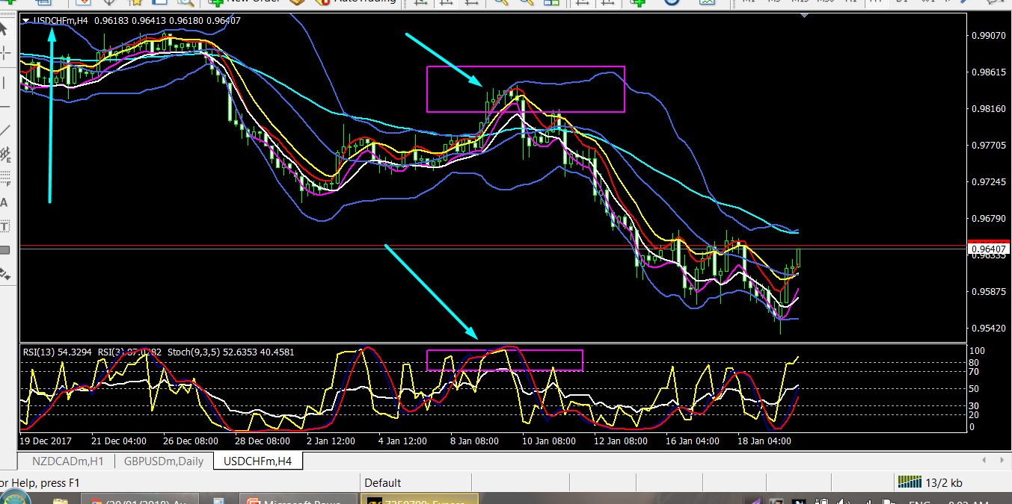

Slide 20
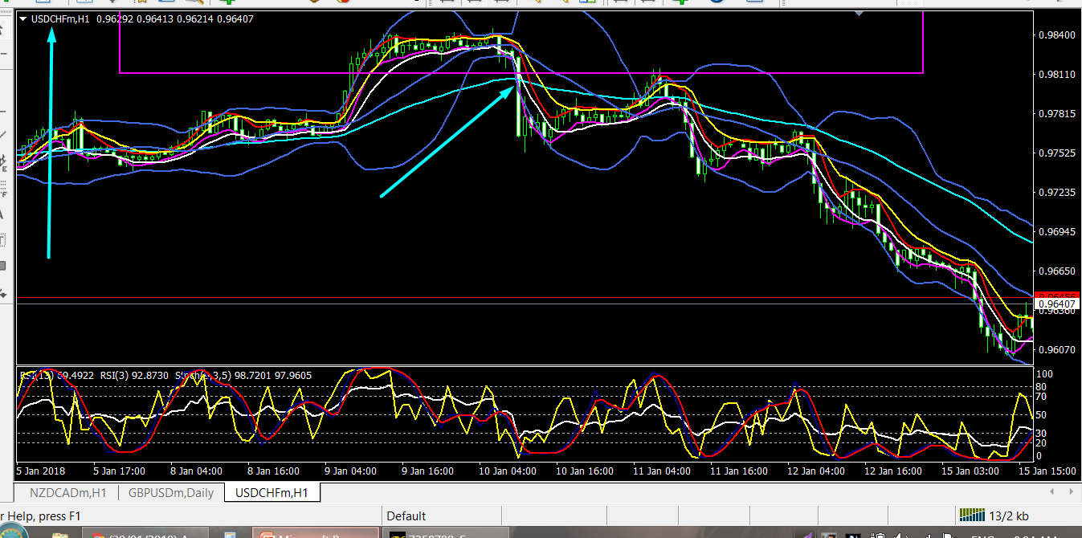

Slide 21
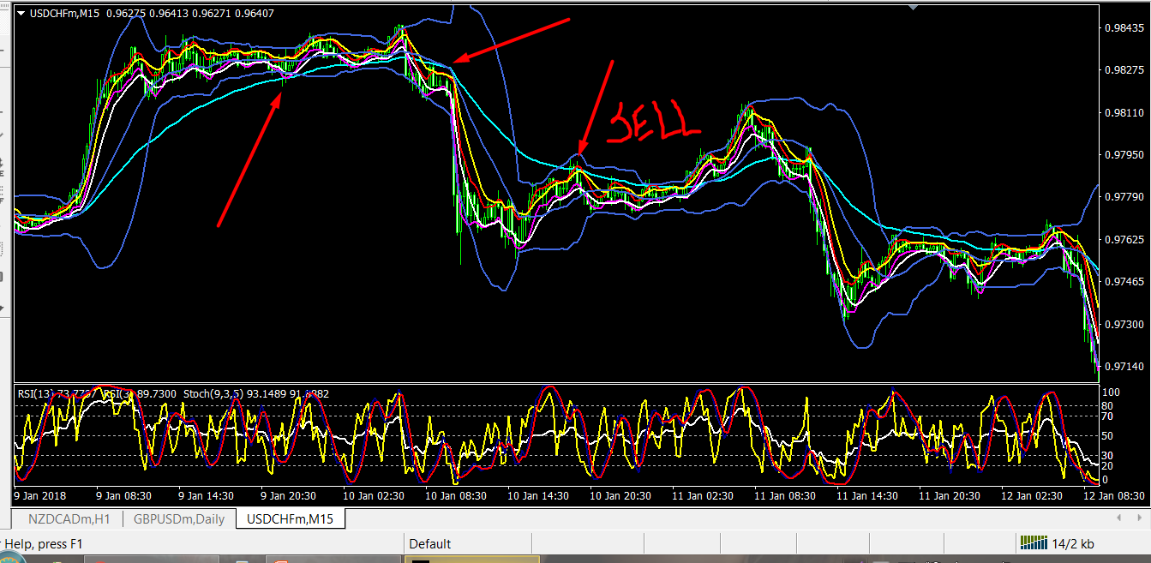

Slide 22
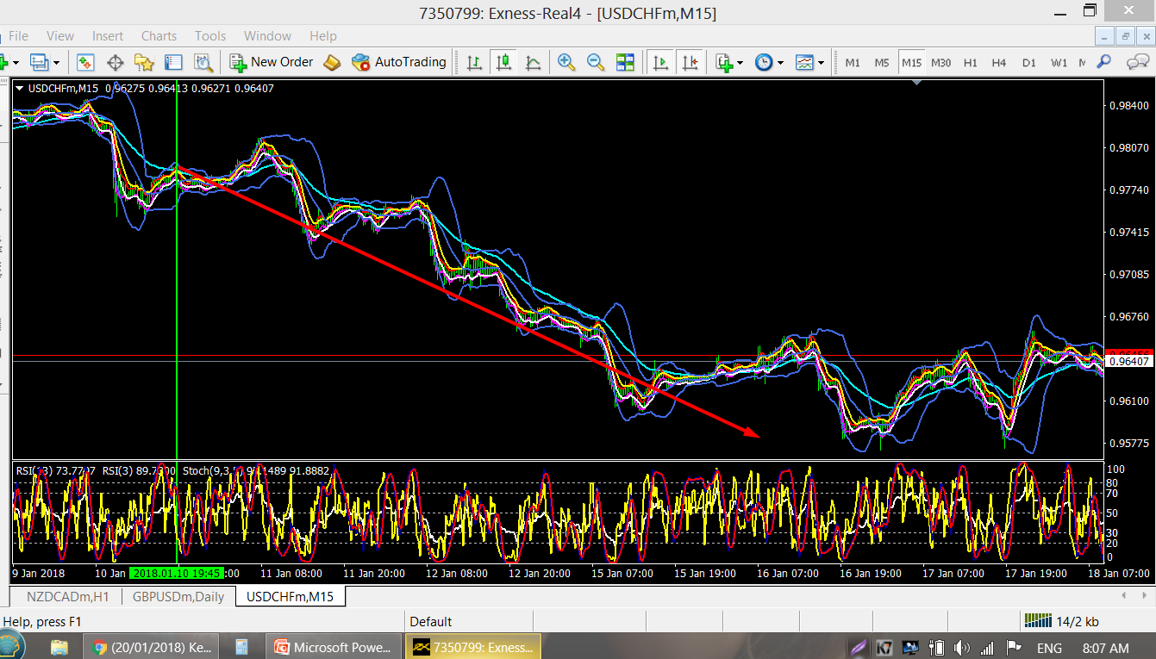
CHECK THE TREND NOW BOOM IT S THE POWE R OF ZERO LOSS ZONE

Slide 23
NOW MOST IMPORTANT SL AND TP AND MONEY MANAGEMENT AND RISK MANAGEMENT
Your risk reward will be 1.2 not more than that not less than that 1.2 is the best risk reward with good accuracy of 90 percent if you follow all rules you win rate will be 90 percent donot place stoploss above candle high only amatuer trader place stop loss above high and market maker will hunt sl easily first check your tp if your tp is 100 then your sl will be 50 pips you risk only percent per trade if you win 10 trade its enough for month you acount will grow 20 percent so risk low and get some money in your account if you want more money increase your equity money 1000 deposit 200 will be your month profit many traders think deposit 100 risk more and then make 200 dollar in 1 trade so only many traders loss within 2 weeks

Slide 24
BBMA ZERO LOSS ZONE
I will show my trades in future how to spot trades sl and tp hope I explained what I now in this presentation so pray for me and my health and family
Thank you

