Slide 1


Slide 2
Advance BBMA
Multiple Time Frame – Ema50 Re-entry situation
Ema50 is a strong indicator for Trend, can be down or uptrend. In advance BBMA, we can use BB and Ema50 as a Re-entry signal
BBEMA – is a Re-entry situation, to see it, we use only TWO time frames
There’s 3 Re-entry BBEMA situations
When BB squeeze/declines and Ema50 goes completely outside the BB, it implies a Re-entry on the bigger TF
When BB squeeze/declines and Ema50 is closer to the BB and is inside, it implies a Re-entry on the bigger TF
When BB is Horizontal and Ema50 is outside and near/parallel to it, it implies a Re-entry on the bigger TF. On this one, one or two cs’s Re-tests Ema50 outside
Ema50 above cs, Re-entry sell
Ema50 below cs, Re-entry buy
Low BB for buy Re-entry
High BB for Sell Re-entry

Slide 3
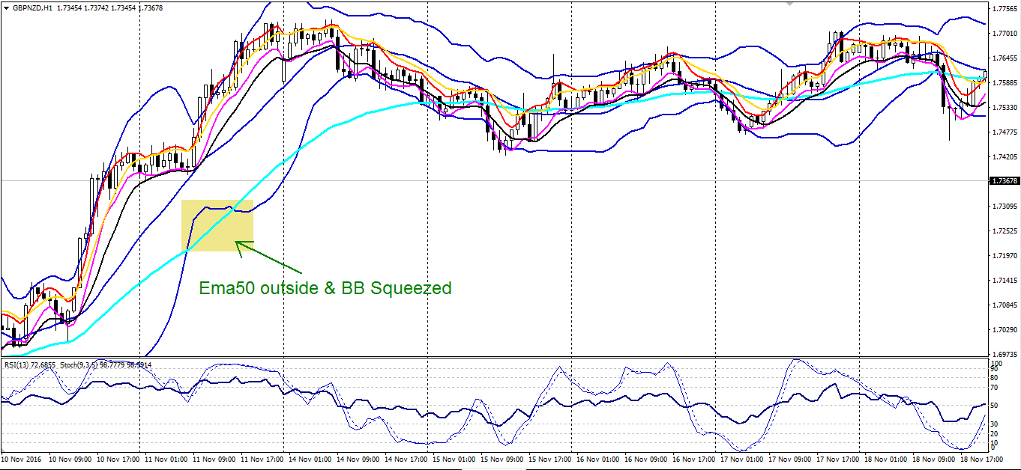
Situation 1 BBEMA – H1 TF

Slide 4
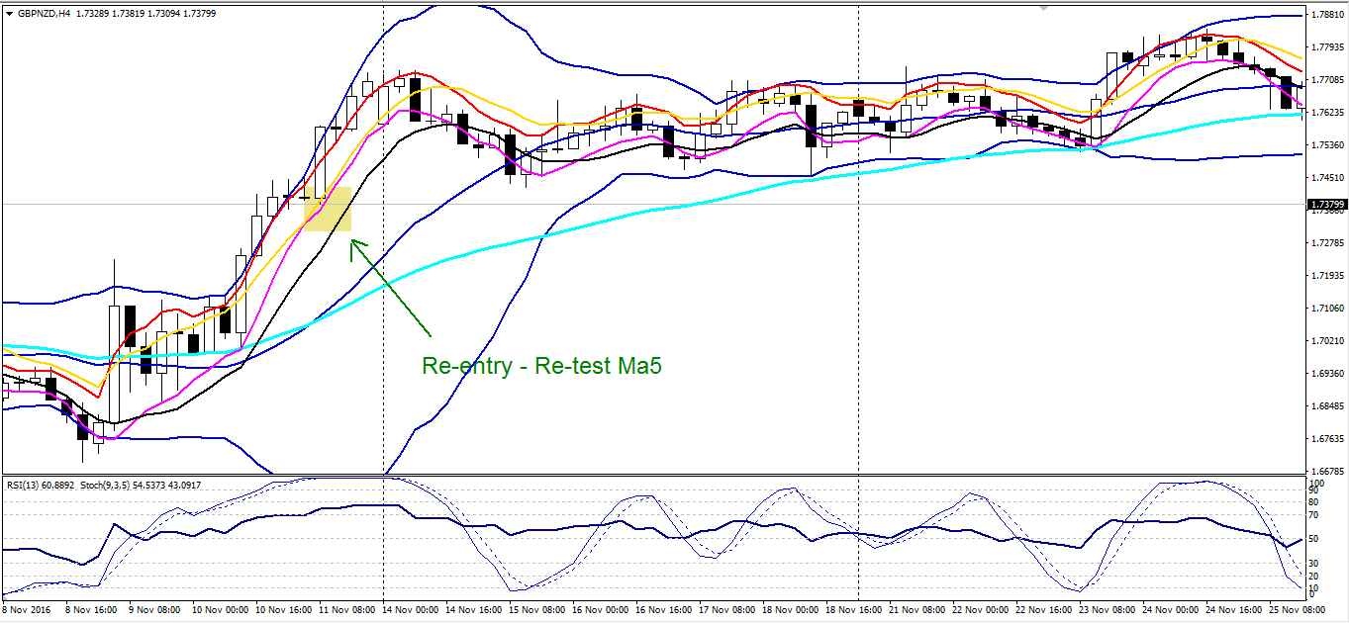
H4 – Re-entry

Slide 5
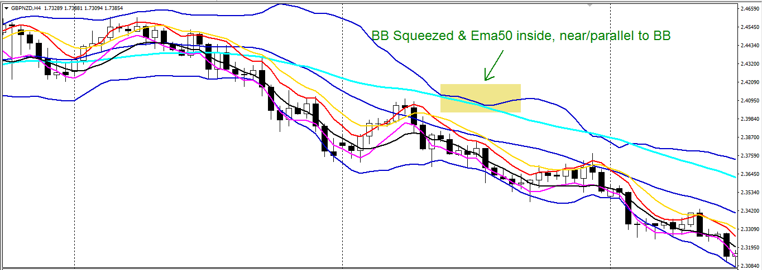
Situation 2 BBEMA – H4 TF

Slide 6
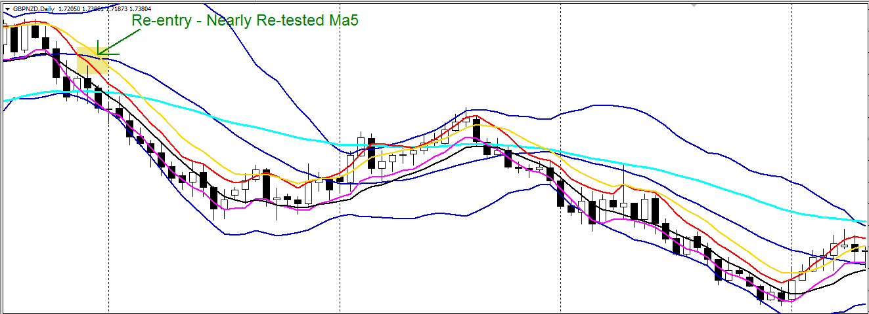
Daily TF – Re-entry

Slide 7
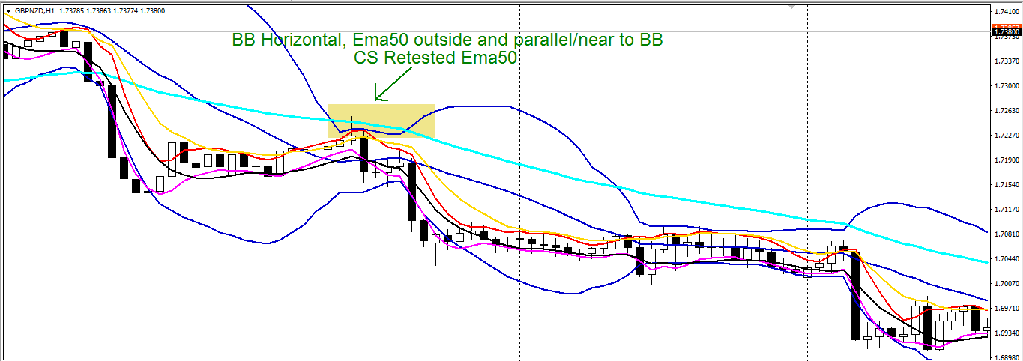
Situation 3 BBEMA – H1 TF

Slide 8
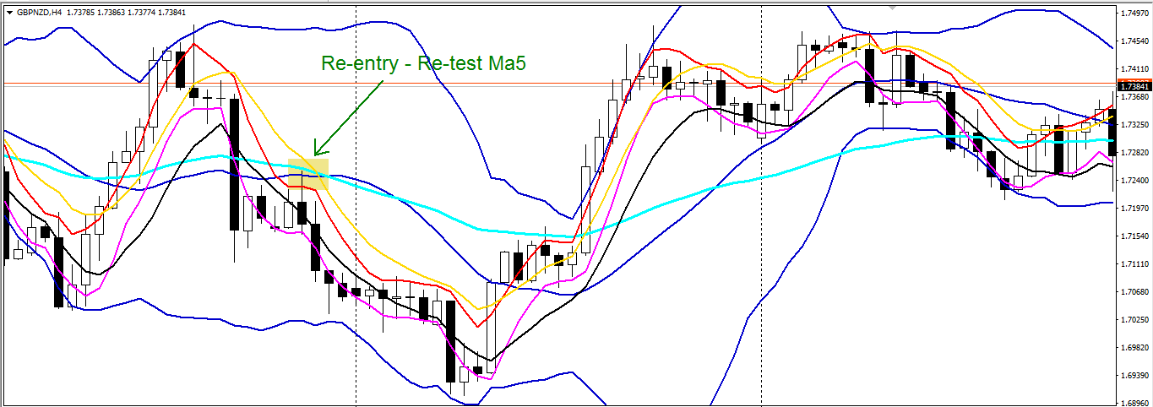
H4 – Re-entry

Slide 9
Multiple TF; Major and Manor Movement
This Movement is for tracking down 80-90% unfinished trend. To spot the Movement, we have Markings. There are 3 main signals/features to spot major and manor movement reversals.
Sideways market = BB Horizontal
MLV or when the market is Sideways and meet with Mid BB
Sideways market and gives us a Re-entry
How to see Major & Manor or SOP
Daily – Marking, if you get any of the 3 features(sometimes the market will touch ma5/10)
- For direction (to see trend, use Ema50 if it’s a Downtrend or
Uptrend
- For TP, when the markets touches Ma5/10
H4 – Confirmation TF
- also for TP
H1 – Entry TF
- Apply basic BBMA diagram/7 steps for entry

Slide 10
Example; Major (weekly – H1 but manor is from H1-m1)
This is the standard SOP of the Movement
Daily – Feature/marking, BB horizontal = sideways market
- Tp when market touch Ma5
H4 – Has to be an MLV
H1 – if there’s an Extreme, it’s a bonus. But compulsory signal you have to see is MLV and CSD and enter on Re-entry (sometimes there won’t be a R-entry, the market will retest the previous low/high or create a double top/bottom)

Slide 11
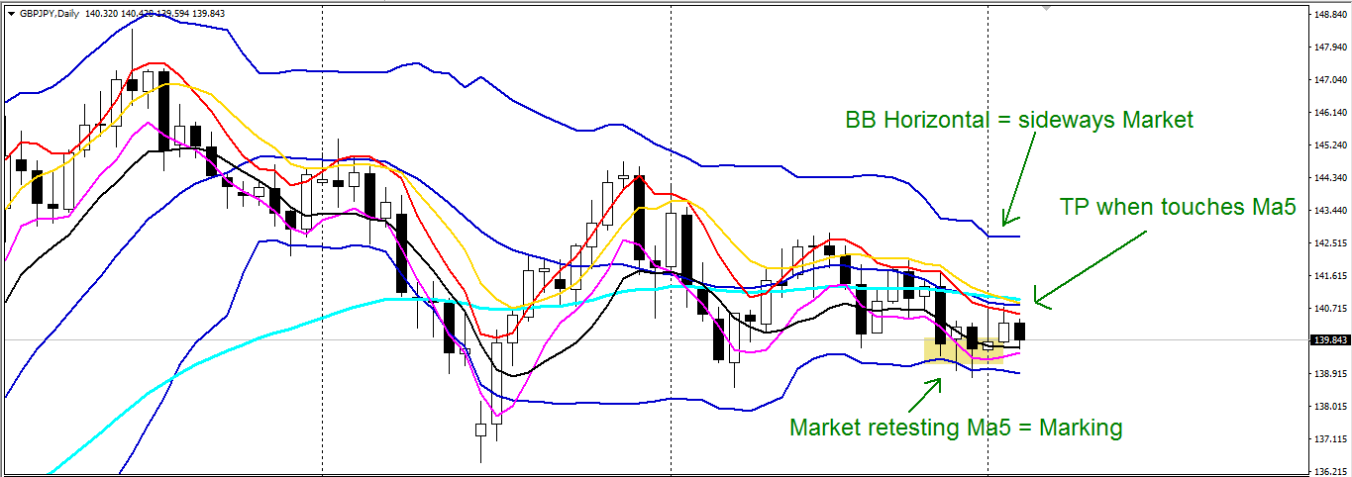
Illustration of Major Movement
Daily – Feature/marking, BB horizontal = sideways market
- Tp when market touch Ma5

Slide 12
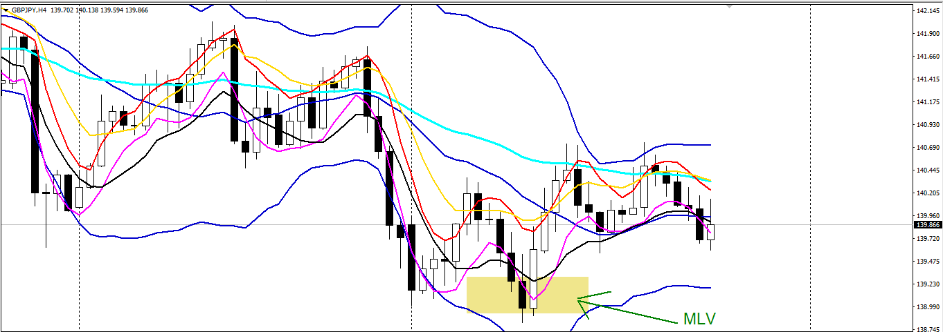
H4 – Has to be an MLV

Slide 13
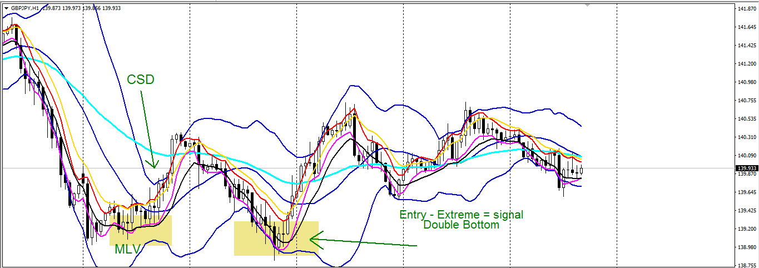
H1 – Extreme – Double bottom

Slide 14
Extreme “C” signal
Extreme “c” is more of a hidden Re-entry
We see it using Ma5/10, when candles sticks and close outside of it
This helps us to see a strong Momentum in the market
SOP of Extreme “C”
Big Tf, a candle will be outside of Ma5/10, acting as a CS Momentum
Middle Tf, we need to see a Re-entry
Smaller Tf, we have to see an Extreme C/BBEMA (Ema50 Re-entry situation)

Slide 15
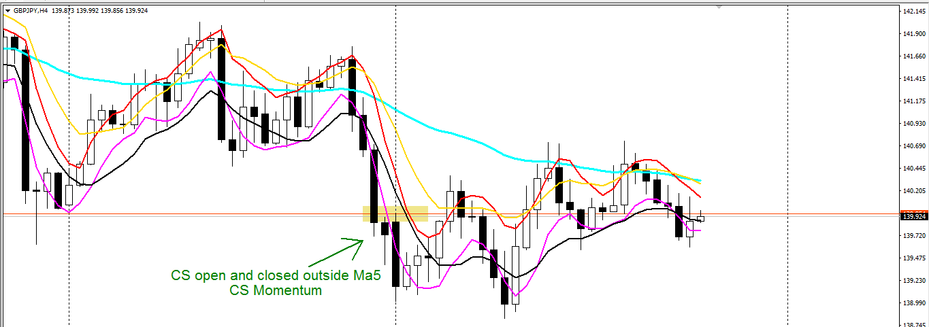
Extreme “C” Illustration
H4 – CS Momentum – outside Ma5

Slide 16
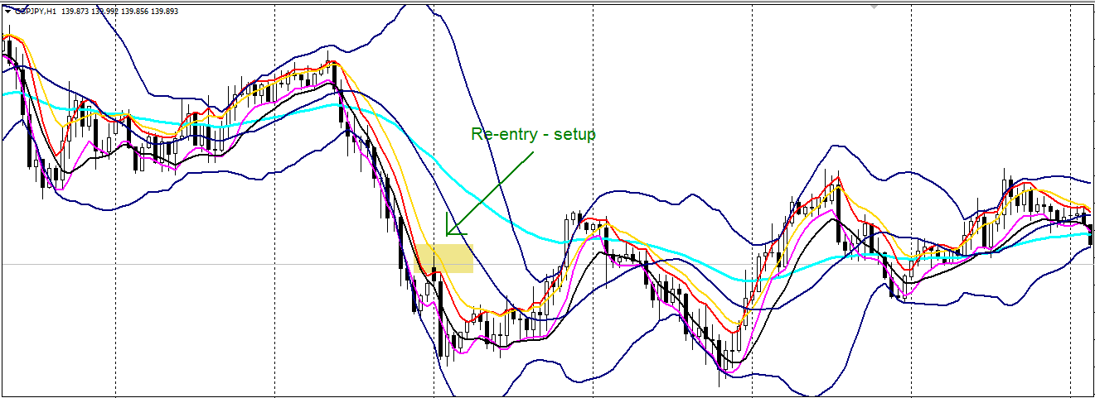
H1 – Re-entry

Slide 17
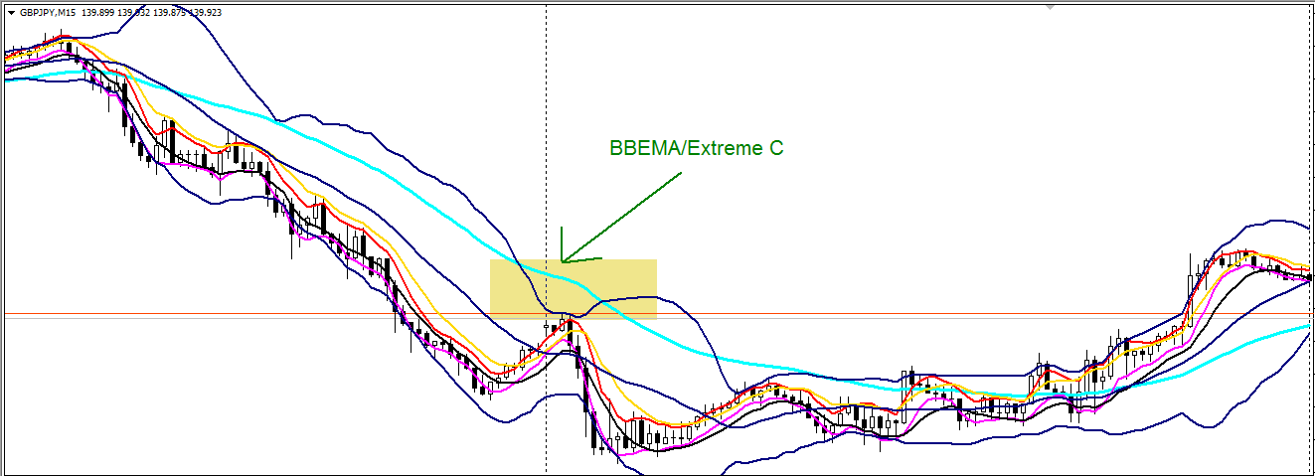
M15 – Extreme C/BBEMA

Slide 18
Diamond Setup
Diamond Setup is 100% accurate.
It happens when Ma5/10, Ema50 are parallel to Mid BB, it shouldn’t be far from Mid BB
There should be 3 cs to re-retest/reject Ema50 and enter on the forth one. Sometimes you get less cs retesting/rejecting
You Tp when the market reach previous Low/High
If there was an extreme before, the Diamond setup will be very
SL 10 pips away
For Buy, Ema50 should be below Mid BB
For Sell, Ema50 should be above Mid BB

Slide 19
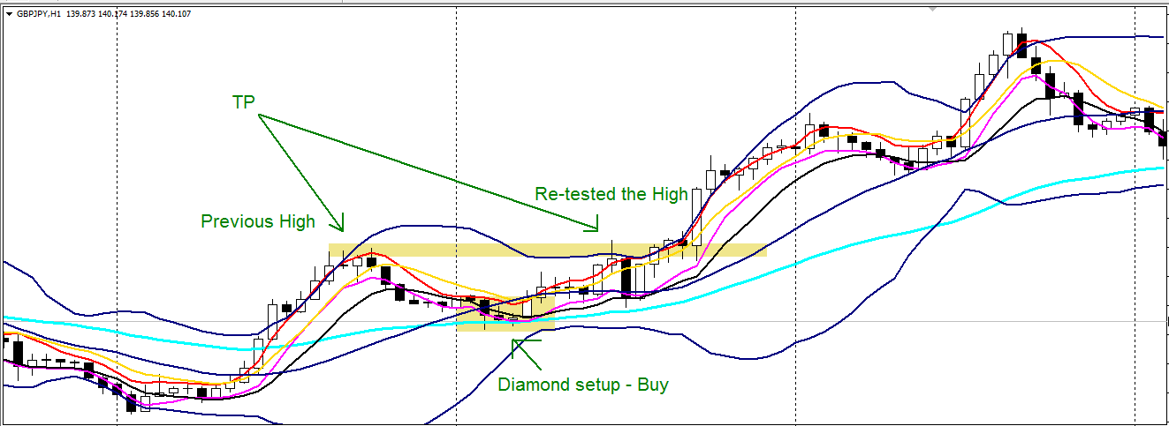
Diamond setup Illustration

Slide 20
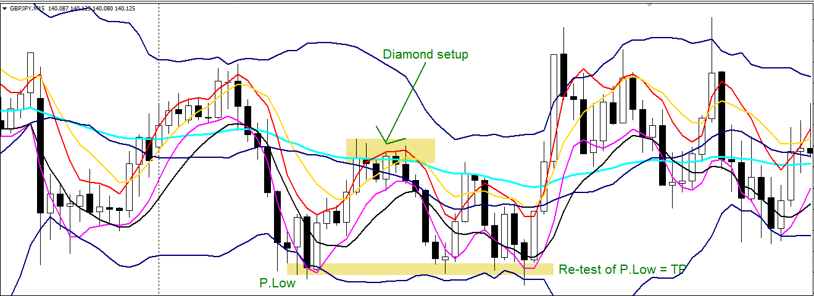
Diamond Setup – Sell Illustration

Slide 21
Golden Setup
Golden Setup is a powerful Re-entry situation
There’s Two kinds of Golden Setup
Golden Setup that has Extreme “C”
Golden Setup that has Ema50/BBEMA situation
For Golden Setup, we use Four Time Frames

Slide 22
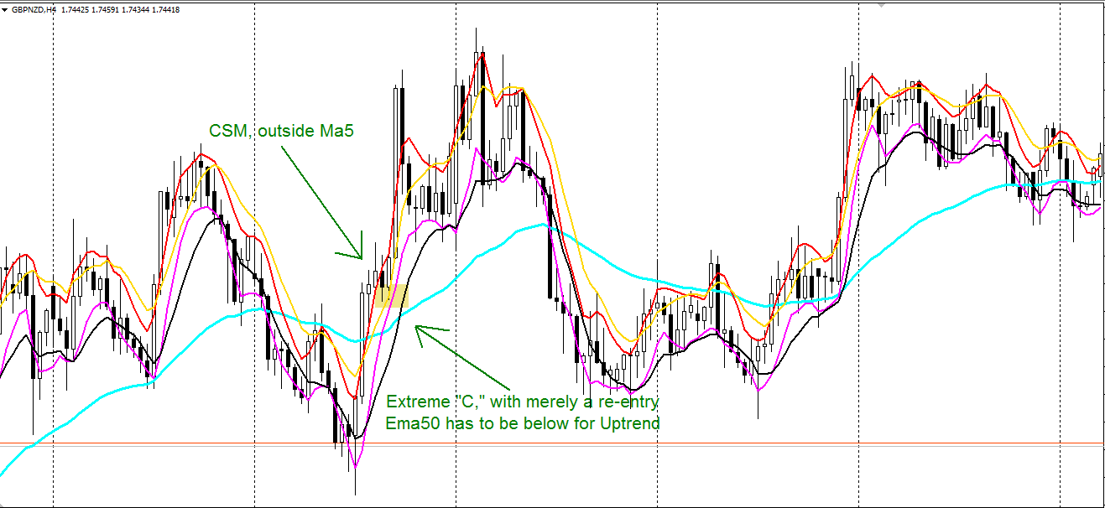
Extreme “C” Golden Setup
Illustration
H4 – Extreme “C” ( cs nearly touch Ma5, but for this setup. Ema50 has to be below but not far from CS. Vice versa for going down.

Slide 23
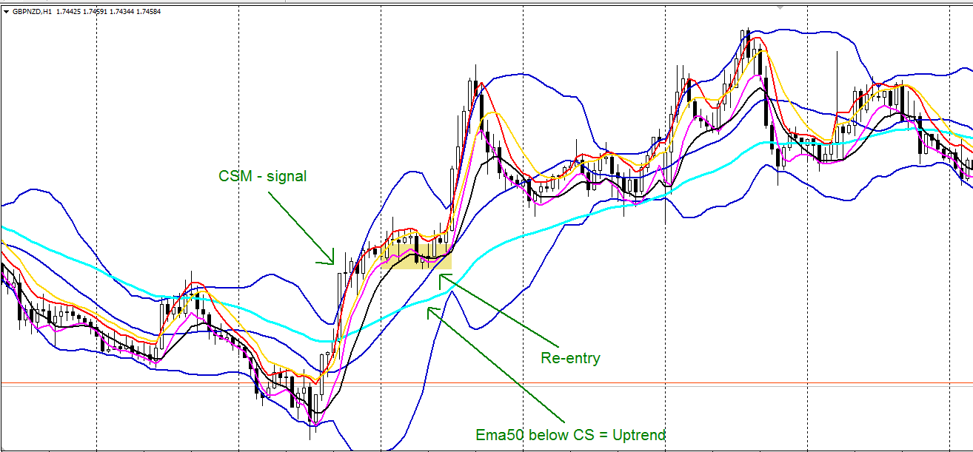
H1 – Re-entry

Slide 24
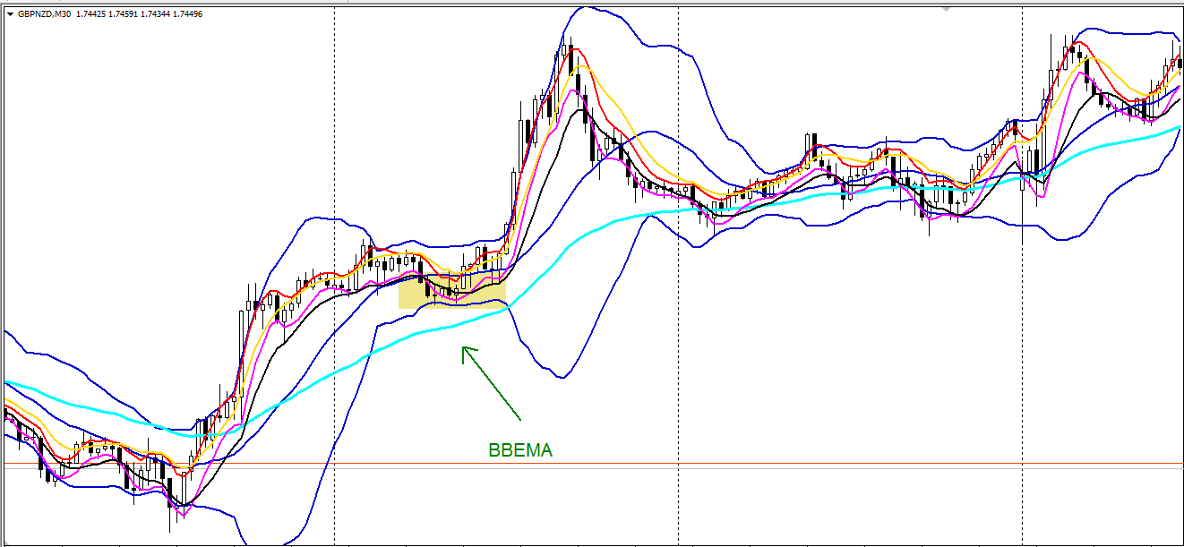
M30 - BBEMA

Slide 25
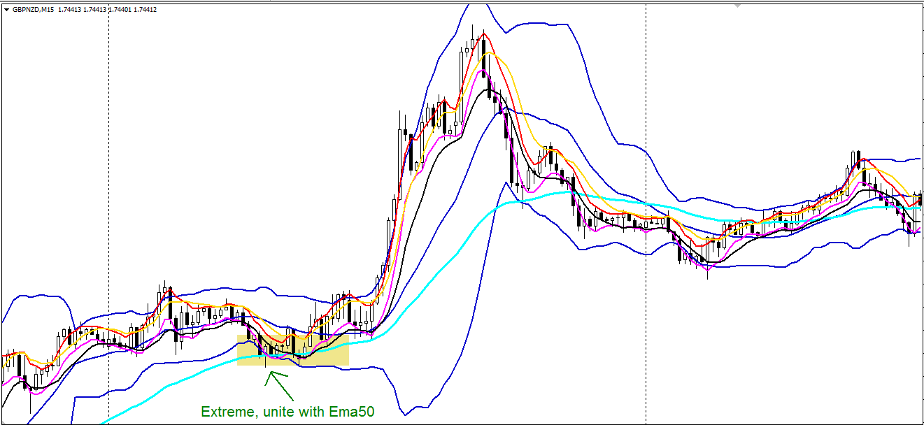
M15 – Extreme (Ema50 unit with Extreme. As long as Ema50 is within the extreme zone, it’s fine)

Slide 26
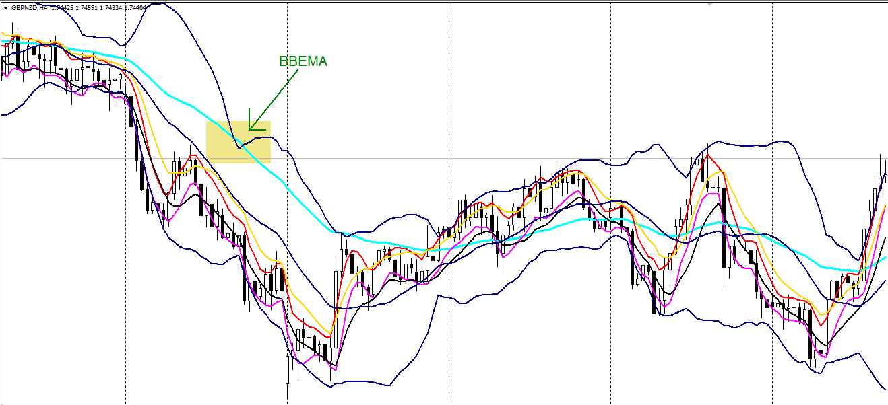
BBEMA Golden Setup
H4 – BBEMA

Slide 27
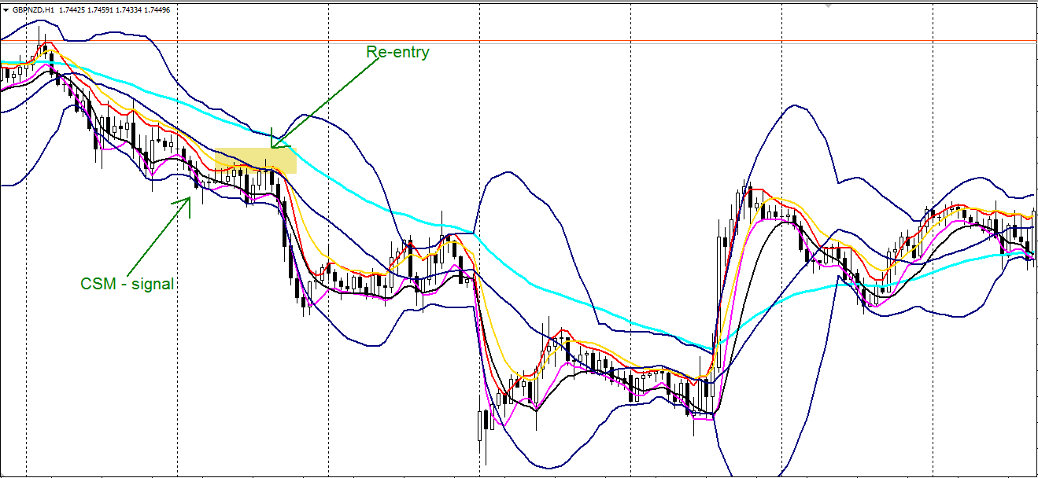
H1 – Re-entry

Slide 28
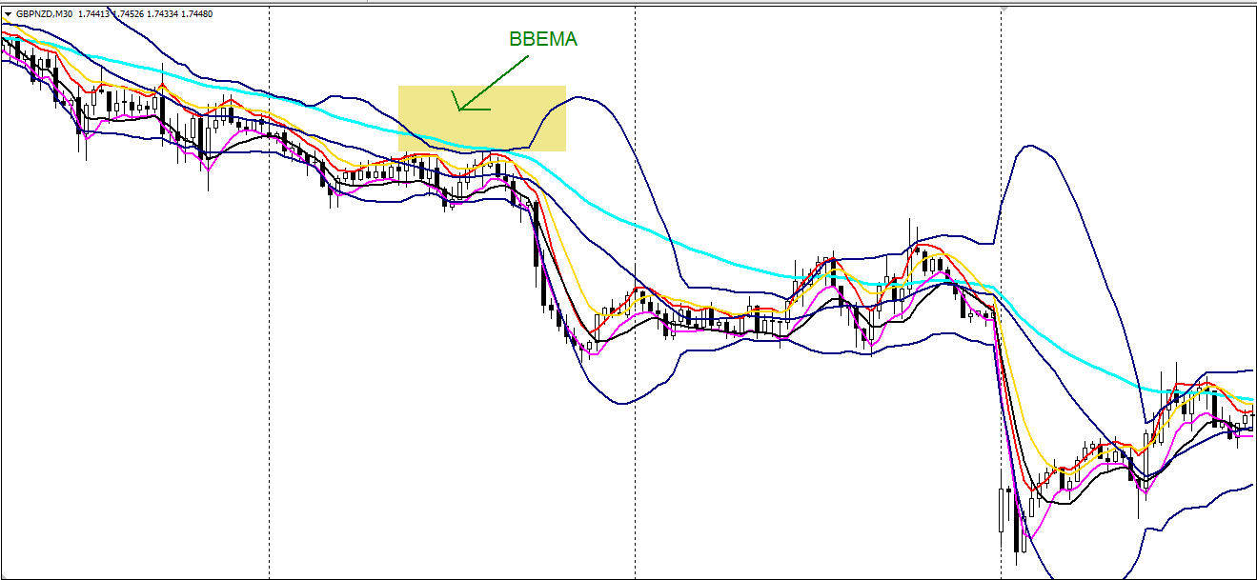
M30 – BBEMA (as long as Ema50 is above for going down on this TF it’s fine)

Slide 29
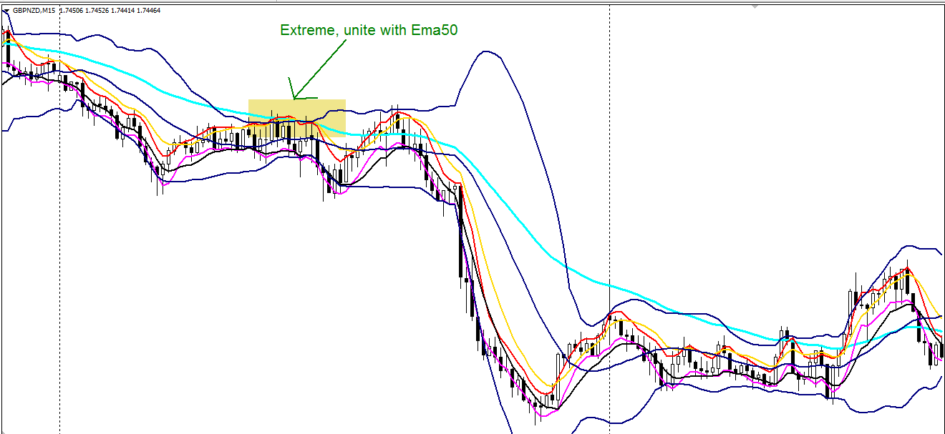
M15 – Extreme, unite with Ema50

Slide 30
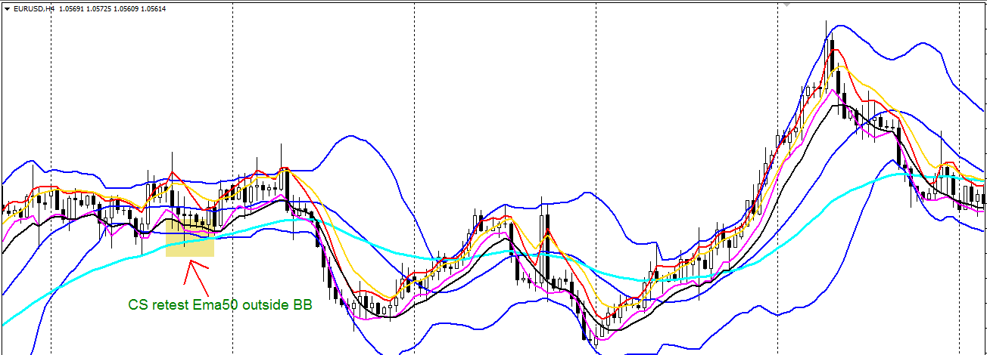
Re-entry situation formation Uptrend - (EurUsd only)
H4 – candles will retest and reject Ema50 while outside the BB

Slide 31
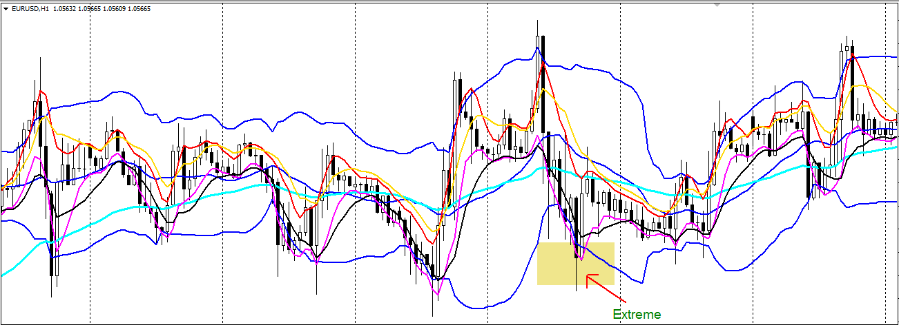
H1 – Extreme

Slide 32
M15 – There has to be an Extreme
I couldn’t go back on M15 where there was an Extreme because it’s too far.

Slide 33
Setup RMR
If there’s no REM (Re-entry – Extreme – MLV) there’ll be a setup called RMR which is a Re-entry – MLV – Re-entry.

